Slide 1
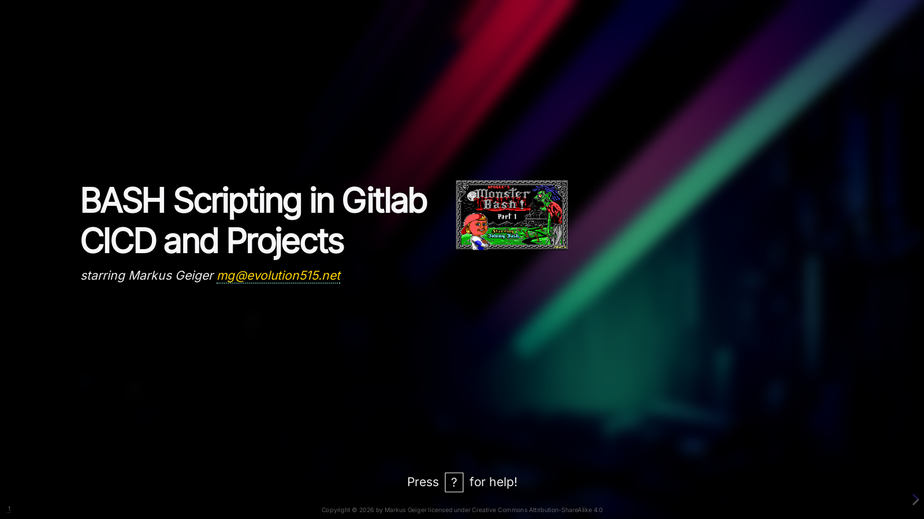

Slide 2


Slide 3
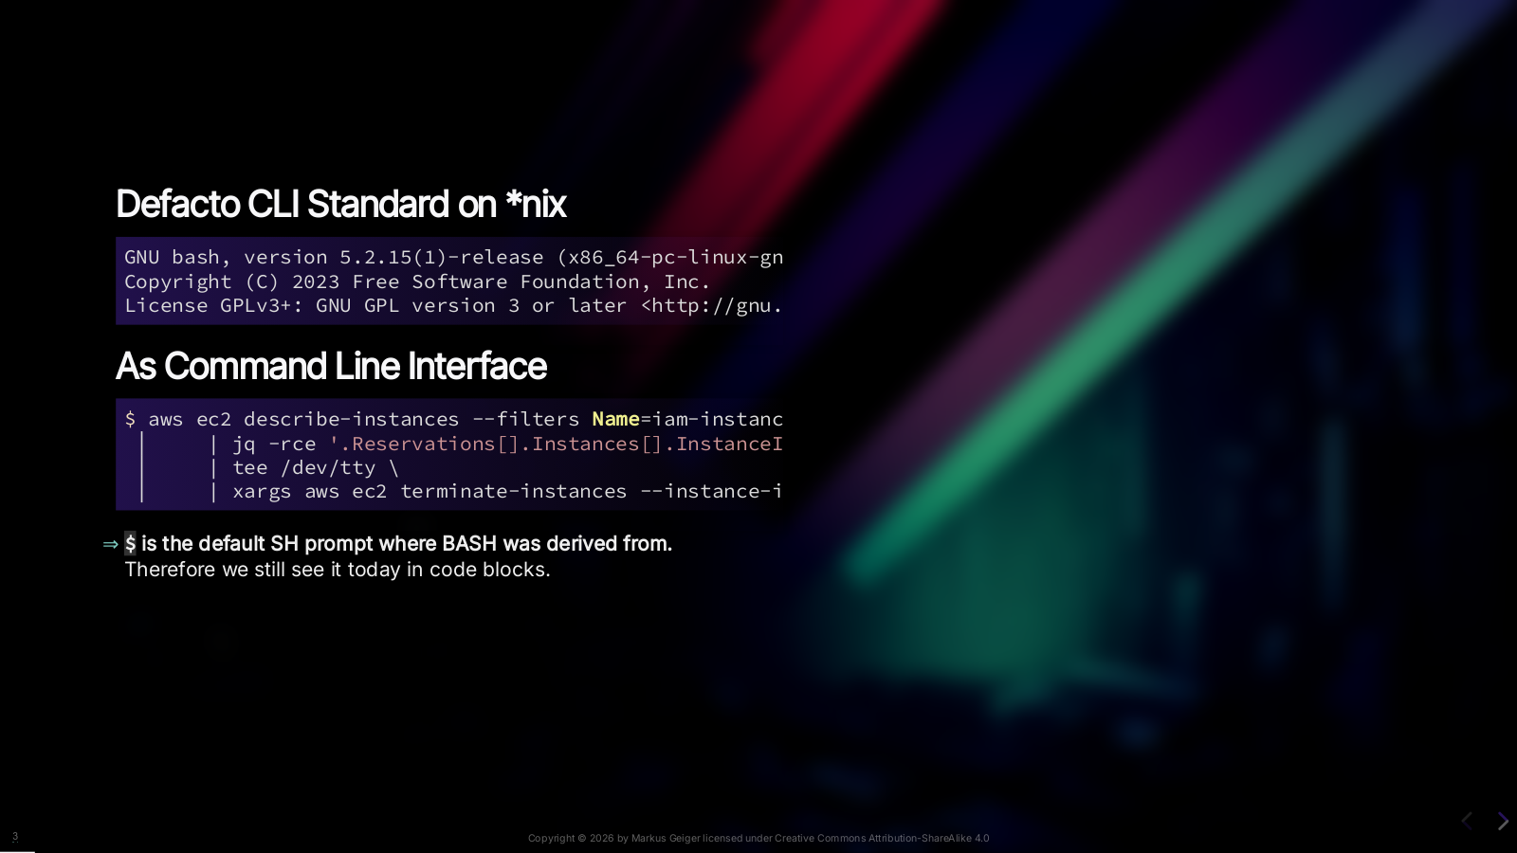
Notes:
BASH is a Command-line interpretor and also scripting language. CLI stands for command line interface of course. BASH is default for many Linux, Unix and BSD system. Therefore we also use sometimes the `(wildcard)*nix` abbreviation. Note: `$` (dollar sign) is the default SH PS1 prompt therefore we still see it today in examples. `bash` prompts you by user@host:path

Slide 4
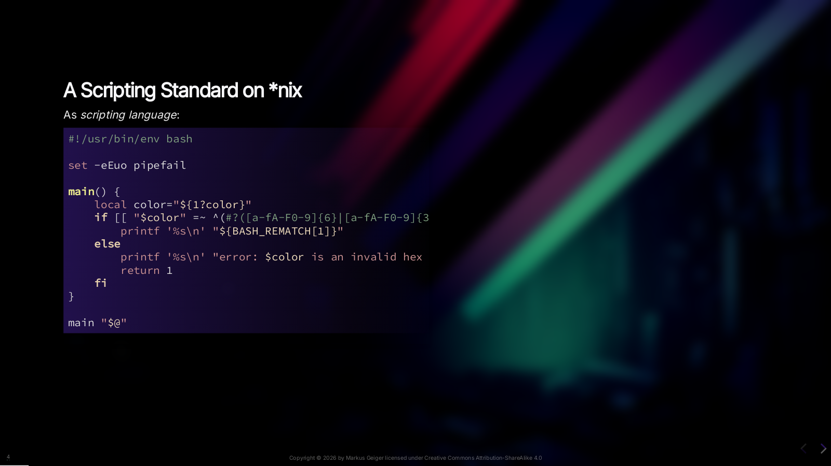
Notes:
We are using parameter substitution for error messages, regular Expressions here.

Slide 5
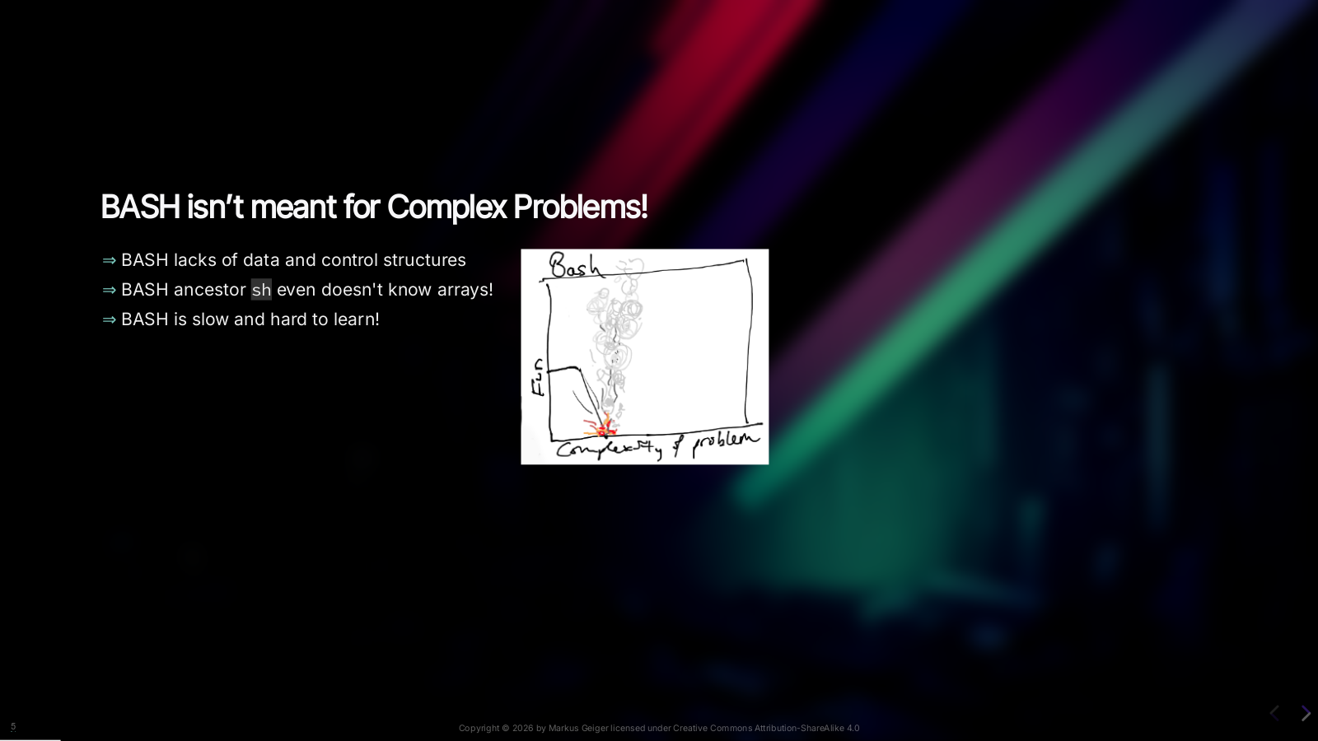
Notes:
BASH isn’t meant for complex problems! BASH lacks of data and control structures like found in Python or other programming languages. BASH ancestor SH even doesn’t know arrays. BASH only knows one-dimensional assoc arrays – and they are not nestable! I guess for a lot of you writing Python more appealing than dealign with BASH.

Slide 6

Notes:
Now these are very essential things to ask yourself. I have seen a lot of BASH scritps that were later rewritten in Python or other languages. The [Google Shell style guide](https://google.github.io/styleguide/shellguide.html) outlines: * If performance matters, use something other than shell. * If you are writing a script that is more than 100 lines long, or that uses non-straightforward control flow logic, you should rewrite it in a more structured language *now*. * When assessing the complexity of your code \[…] consider whether the code is easily maintainable by people other than its author. * And even more … We will reference that style guide more often in this presentation.

Slide 7

Notes:
We dig into a practical example where we uncover the inner working of a gitlab runner. And we want to use our favorite scripting language: Python. NOT.

Slide 8


Slide 9
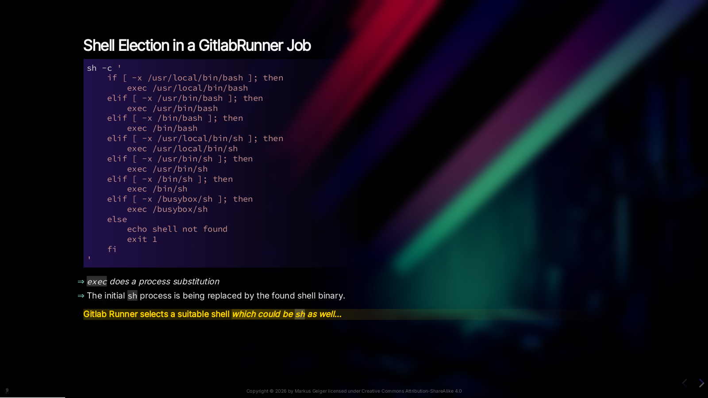
Notes:
GitlabRunner first locates a shell which it wull use to execute your `script:` section. It looks in different pathes for shells. And could also stick to `sh` as well… You’ll find exactly that in Gitlab Runner Golang code.

Slide 10

Notes:
They will fail because they require a shell! And that’s exactly the reason why Gitlab defaults to `:debug` version of the `kaniko` image their documentation. `:debug` has a shell (means a binary) The release version is built as one golang binary. Thus you could also just remove /bin/bash if you don't rely on it as last step in your Dockerfile. That makes sense for security reasons. But probably things

Slide 11

Notes:
They will fail because they require a shell! And that’s exactly the reason why Gitlab defaults to `:debug` version of the `kaniko` image their documentation. `:debug` has a shell (means a binary) The release version is built as one golang binary. Thus you could also just remove /bin/bash if you don't rely on it as last step in your Dockerfile. That makes sense for security reasons. But probably things

Slide 12

Notes:
They will fail because they require a shell! And that’s exactly the reason why Gitlab defaults to `:debug` version of the `kaniko` image their documentation. `:debug` has a shell (means a binary) The release version is built as one golang binary. Thus you could also just remove /bin/bash if you don't rely on it as last step in your Dockerfile. That makes sense for security reasons. But probably things

Slide 13

Notes:
They will fail because they require a shell! And that’s exactly the reason why Gitlab defaults to `:debug` version of the `kaniko` image their documentation. `:debug` has a shell (means a binary) The release version is built as one golang binary. Thus you could also just remove /bin/bash if you don't rely on it as last step in your Dockerfile. That makes sense for security reasons. But probably things

Slide 14
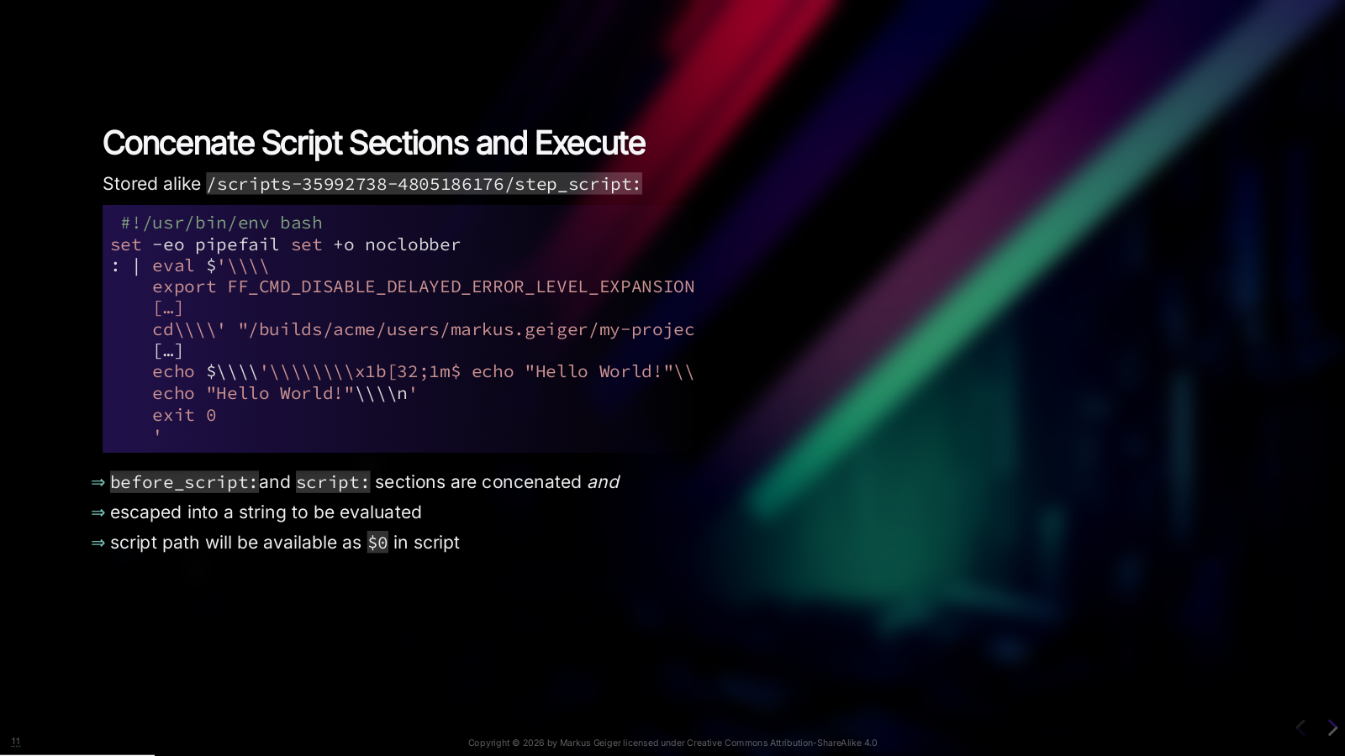
Notes:
We have elected our shell. Now the runner has concatenated everything we had in our `before_script` and `script` section and enriched it with nyce "debug output" (the green lines you see in the job log) And as you could see they put an `#!/usr/bin/env bash` even if `sh` is our elected shell. It also has some BASH options set to immediately exit on failure. We look at them later in detail. Now that while file is piped into the shell process. And job execution begins.

Slide 15

Notes:
We'll look at the shell options in the part abpout debugging

Slide 16


Slide 17


Slide 18
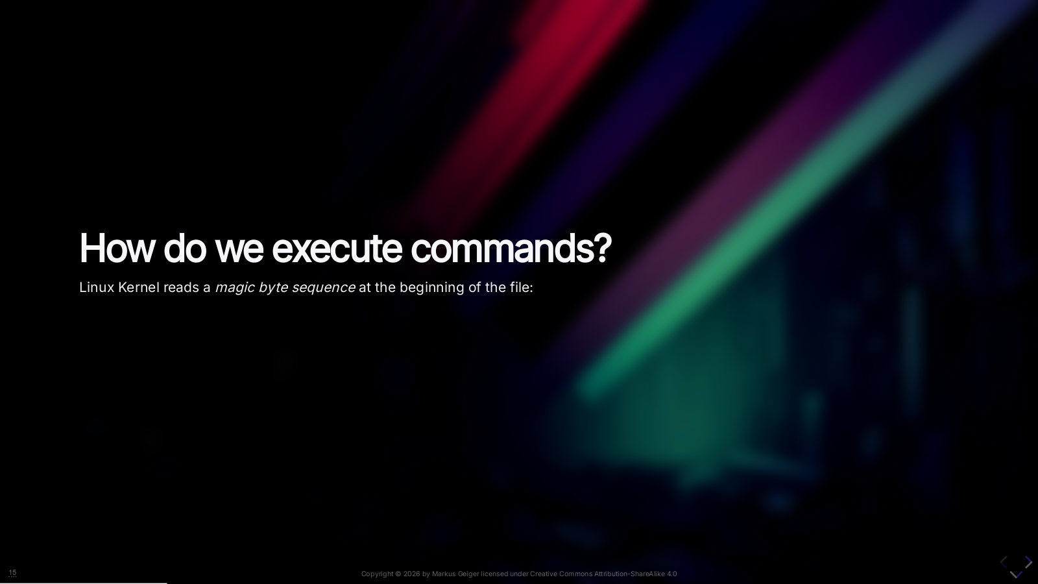

Slide 19
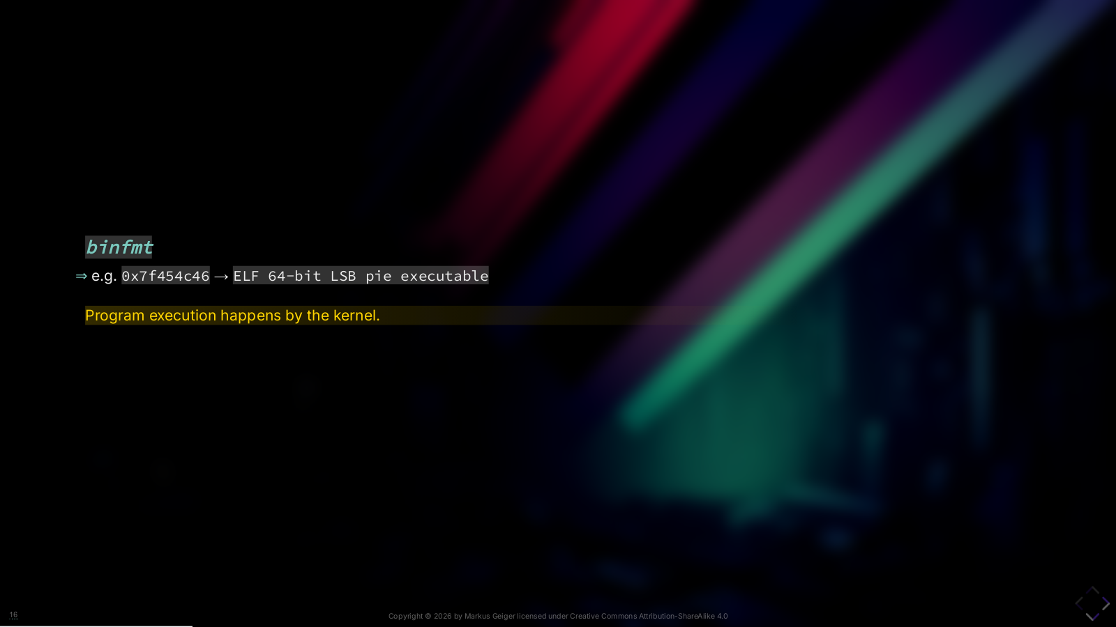
Notes:
The Linux kernel knows mainly two ways to execute a proces. Alway, it reads a *magic byte sequence* at the beginning of the file. For example: for a 64-bit AMD64 ELF (Linux .EXE) that is 0x7f454c46.

Slide 20

Notes:
And then we have a little hack introduced to the kernel decades ago at Bell labs: If the kernel finds `0x2321` (shebang!) the following will be delegated to userspace executor: namely BASH or SH. And that is the reason why you can treat your scipts as commands. <https://www.in-ulm.de/~mascheck/various/shebang/>

Slide 21
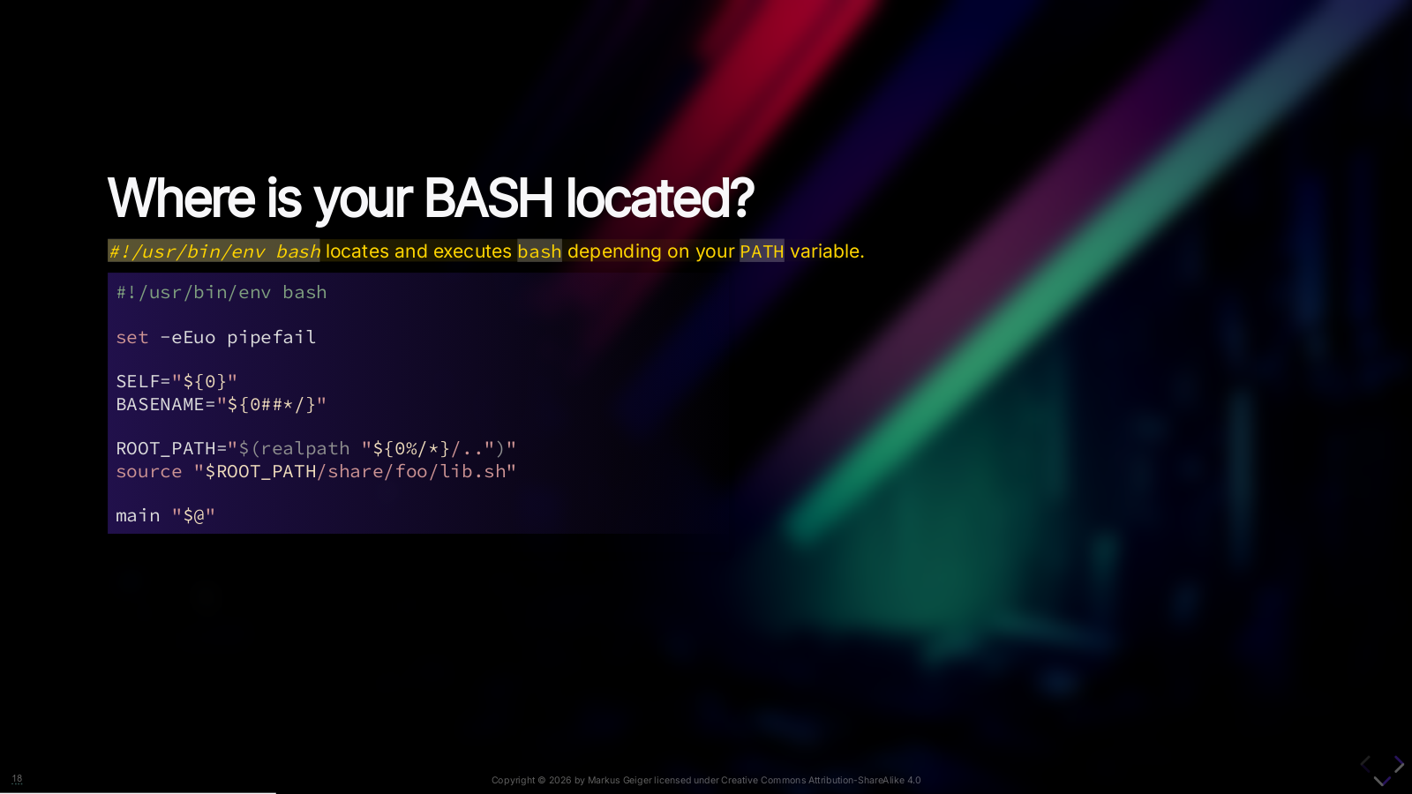
Notes:
As seen in GitLab Runner'S *shell locator* it searches at several default locations for SH or BASH. Script executor locations differ on different linux systems. And therefore we have `/usr/bin/env` which is the default location of that tool in every distribution: * It locates the command given as as argument (here `bash`) * locates it according to your PATH environment variable * and substitutes the current process with it For the advanced people: Don’t add BASH options in shebang line since we do not only have different interpretors for BASH but also different version!

Slide 22
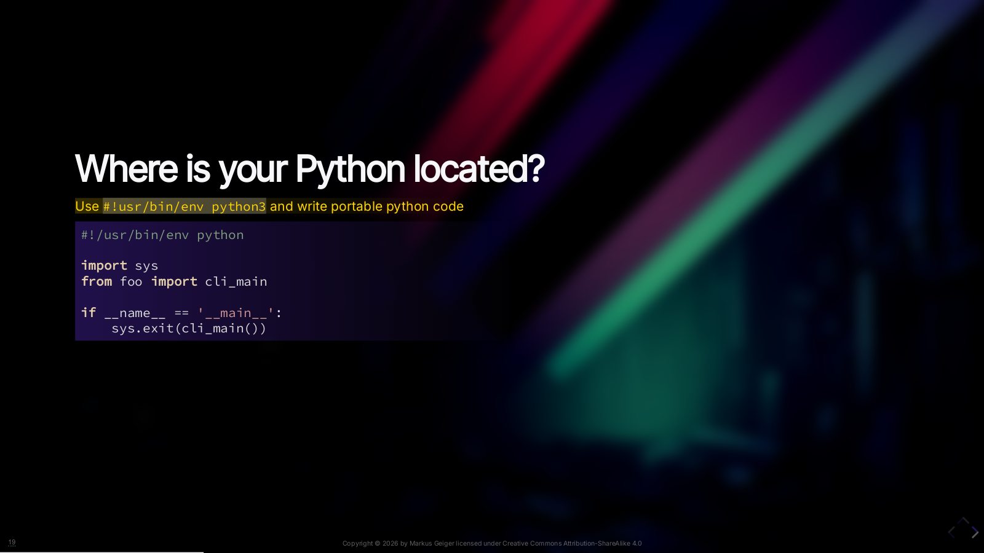
Notes:
Of course you can also use python by that way.

Slide 23
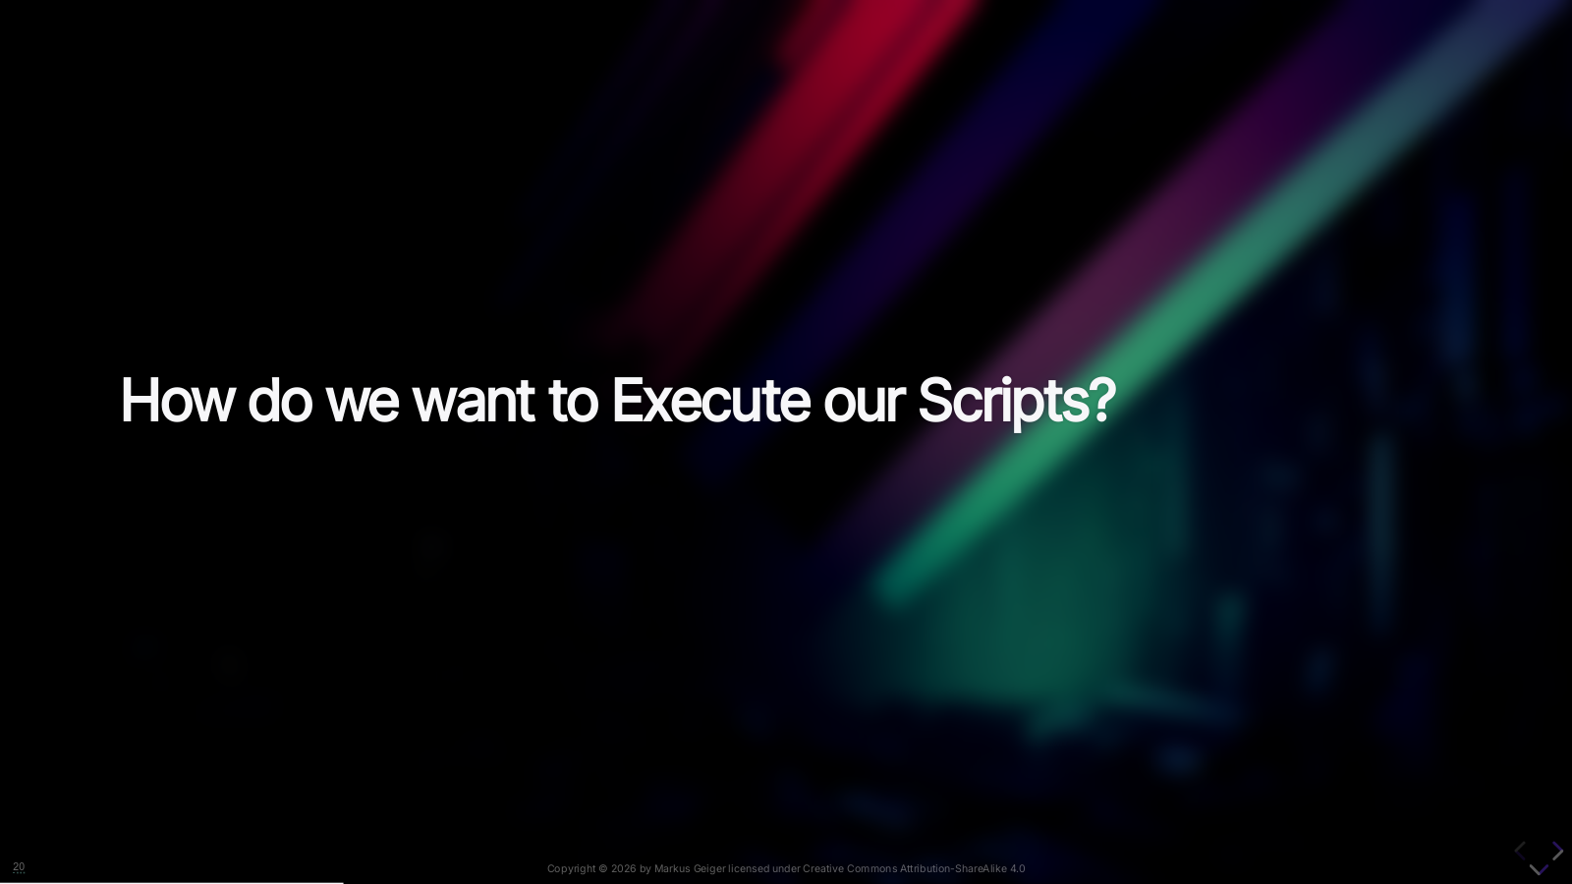

Slide 24
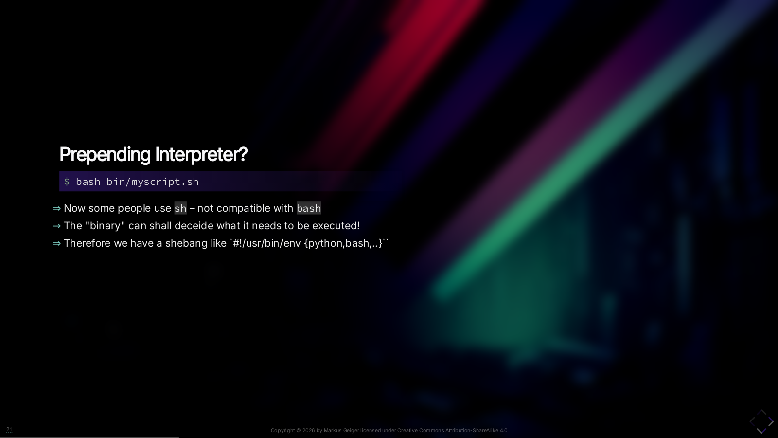
Notes:
So, where are we? That's a pattern I often do see. Why is it bad? The "binary" shall know what it needs to be executed! And therefore we use the Shebang!

Slide 25
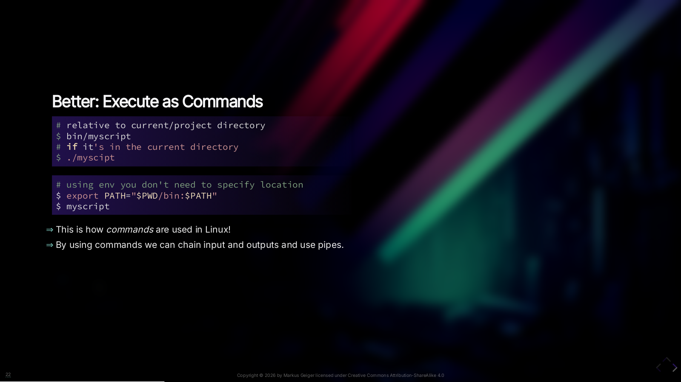

Slide 26
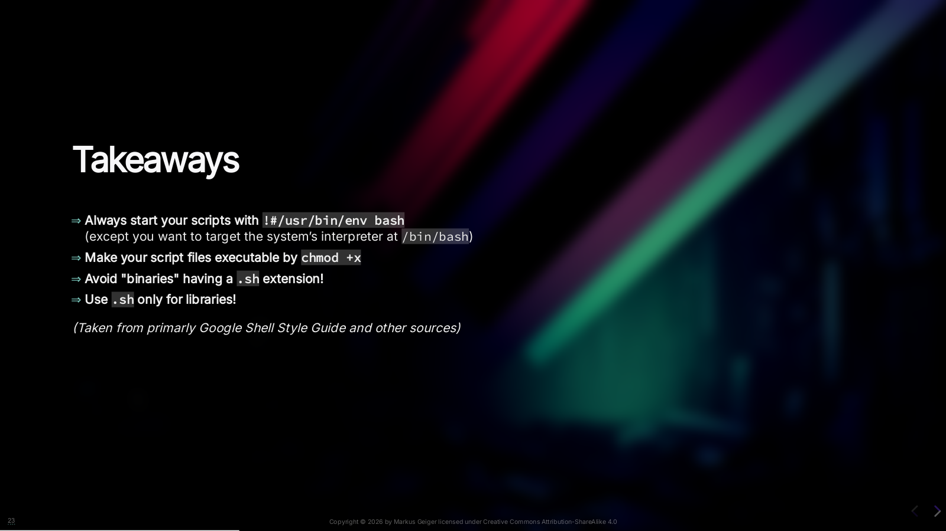

Slide 27


Slide 28

Notes:
POSIX is about Pipes, how processes behave etc. Let's shine light on it by some *forking* history

Slide 29
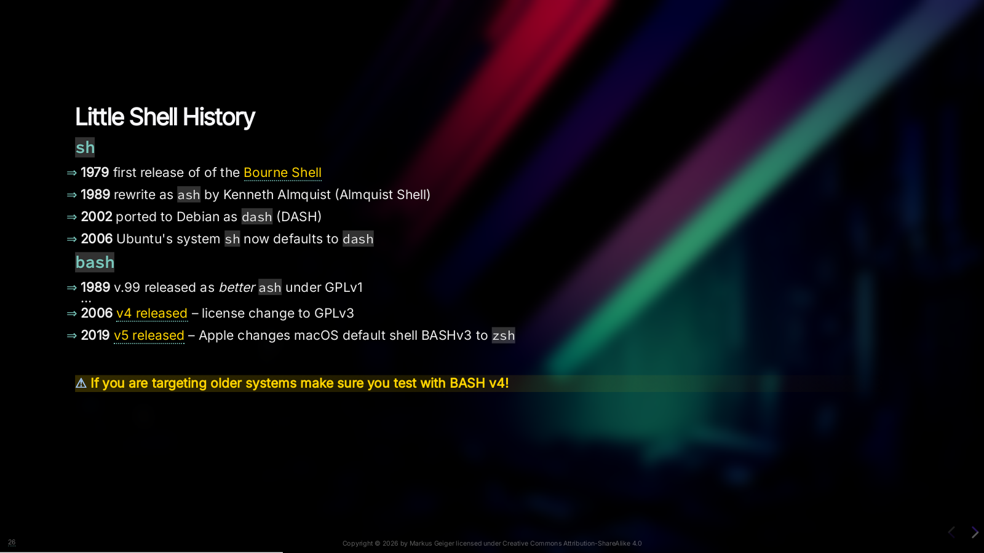
Notes:
It began(?) with Steven Bourne's SH at Bell Labs. That was also the first time the input command line got capabilities to execute script. The ideas here influenced later the POSIX standard based on an SH fork by David Korn. Anyway, we concentrate on BASH and SH only. We have also some interesting history bits on on Debian and Ubuntu to know. But back to Bell Labs: Brian Fox began coding Bash on January 10, 1988 after Richard Stallman became dissatisfied with the lack of progress being made by a prior developer. BASH can execute SH scripts but not the other way round. That will get important with containers and Gitlab CI. So what we can read here or if you don't practise dev-production-parity: * If you are targeting older systems make sure you test with BASH v4. * Don't rely on collegues with macOS still having v3 * They could have still installed BASH v5 with homebrew and use that. As some people think: Apple probably didn't like the license change. Also note: bash has a BASH compat mode (shopt) against API breaks for older versions (compat32, compat40, compat44) Missing BASH version releases: * **1996** v2 * **2004** v3 BASH Licenses * 0.99? to 1.05?: GPL-1 * 1.11? to 3.2: GPL-2 * Since 4.0: GPL-3

Slide 30
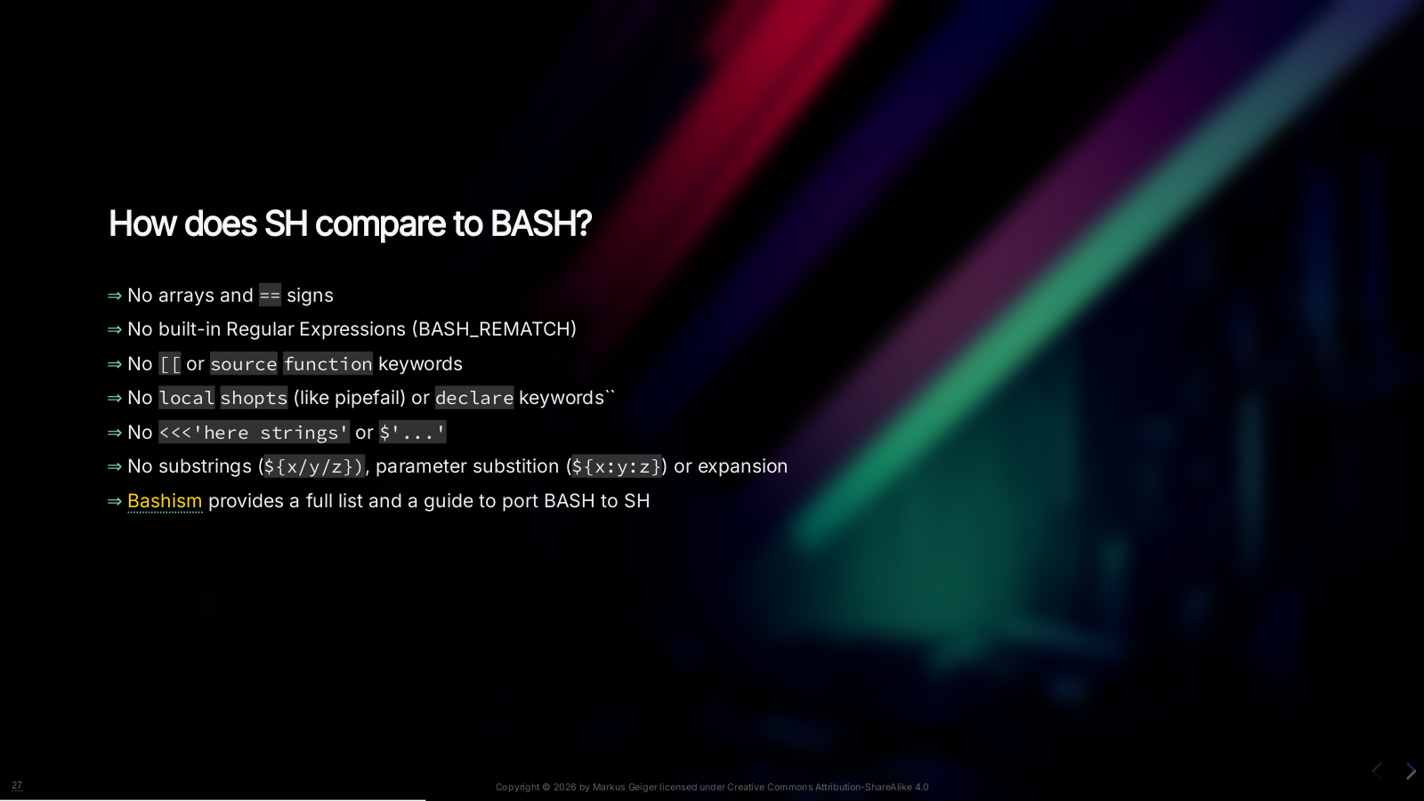

Slide 31


Slide 32


Slide 33
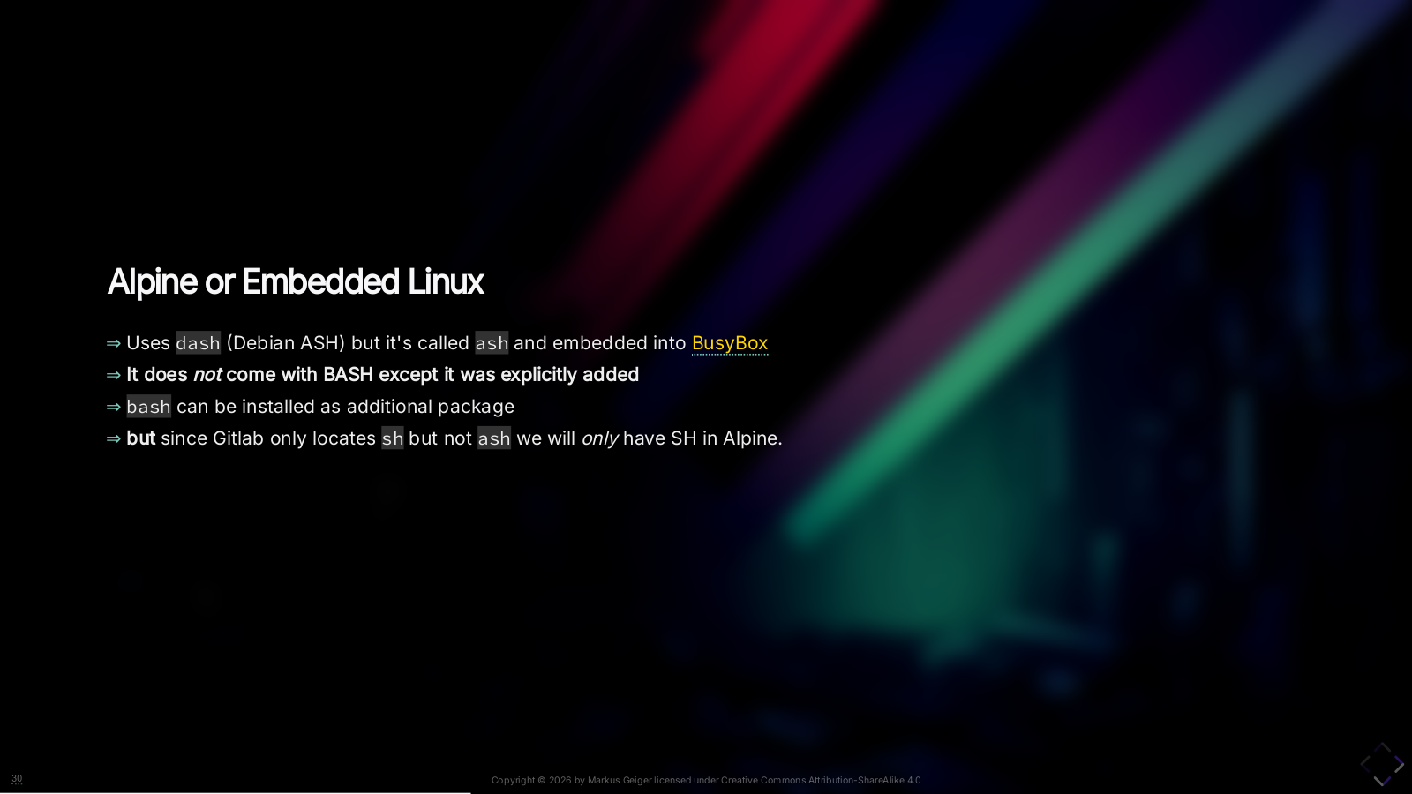
Notes:
You can say most container images do have bash on board. Except Alpine. *(Questions or skip this slide now)* **Common misconception**: Just because `ash` behaves a lot like `BASH` it is NOT a lightweight BASH: In fact it `ash` has an `ASH_BASH_COMPAT` mode! And an`apk add bash` just adds around 700KB to your alpine image! **BusyBox** combines tiny versions of many common UNIX utilities into a single small executable. It provides replacements for most of the utilities you usually find in GNU fileutils, shellutils, etc. which are symlinked to the binary (and by execting the symlink busybox knows what to execute by it's name)

Slide 34
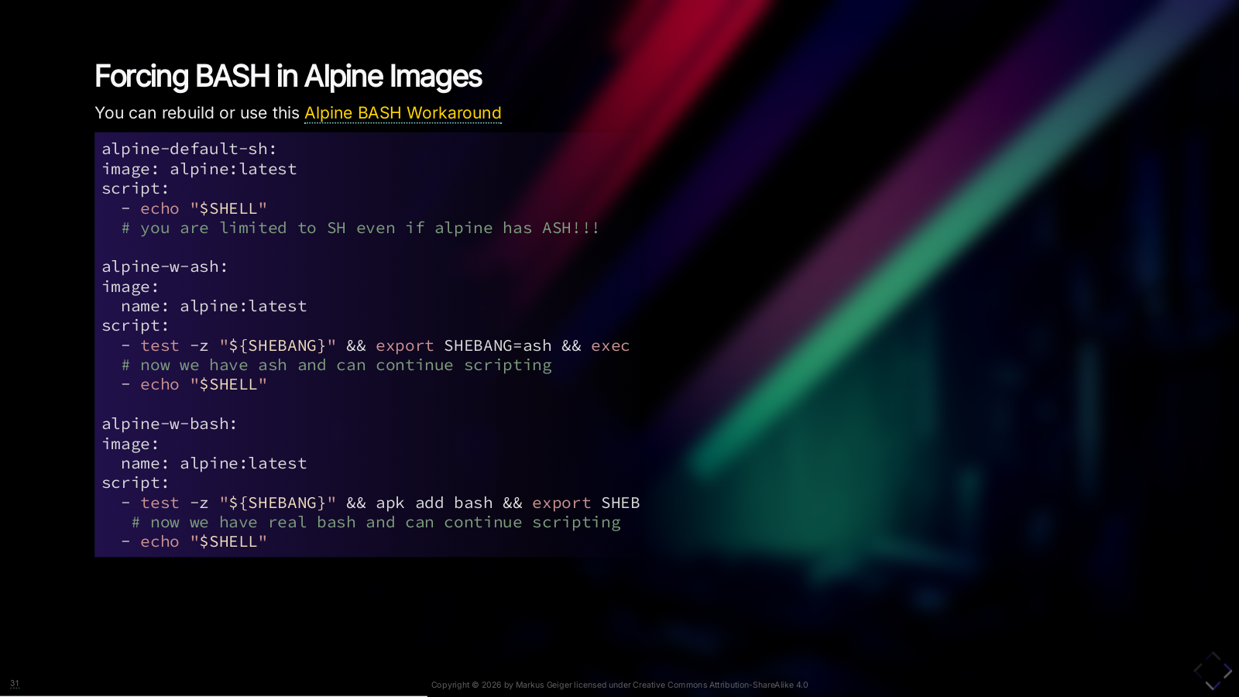
Notes:
Luckily there is a workaround to enable BASH for Alpine ;)

Slide 35
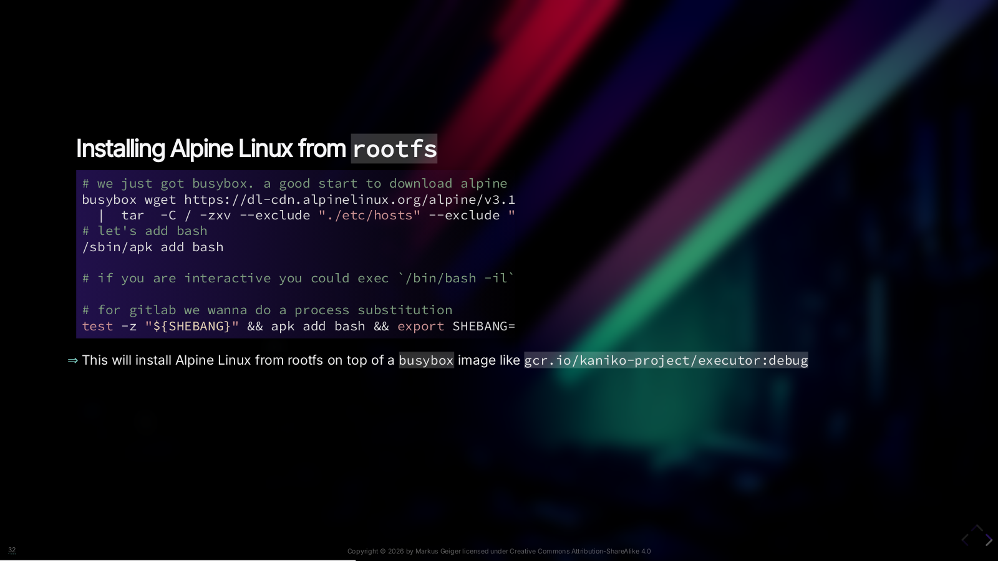
Notes:
And another debug trick I just wanted to mention here.

Slide 36
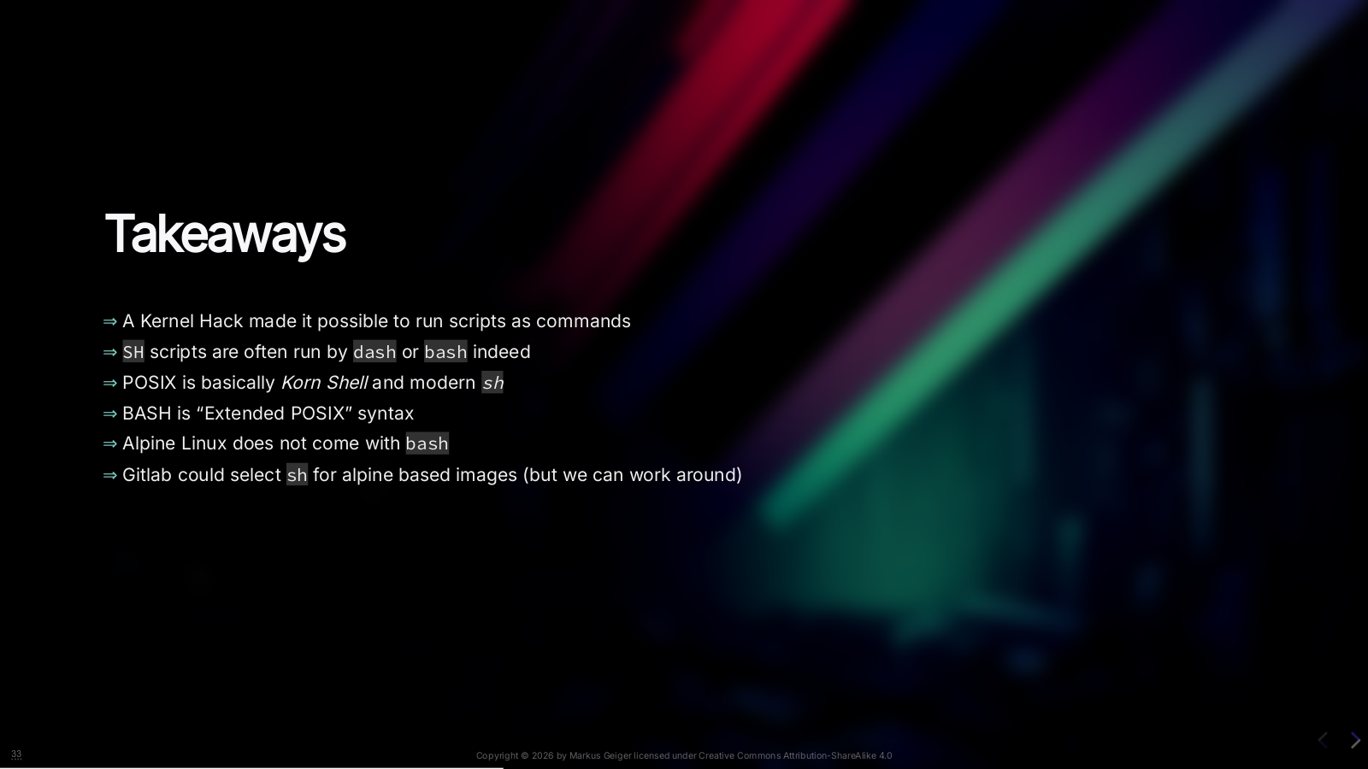
Notes:
* Kernel Hack made it possible to run scripts with a userspace interpreter in "modified environment" as command * SH scripts are indeed run by `dash`` which is faster than `bash\`\`. But bash can also run on POSIX compaitible mode. * POSIX is basically *Korn Shell* and modern *`sh`* * BASH is “Extended POSIX” syntax * Alpine Linux does not come with `bash` by default * Gitlab could select `sh` for alpine based images (but we can work around)

Slide 37


Slide 38
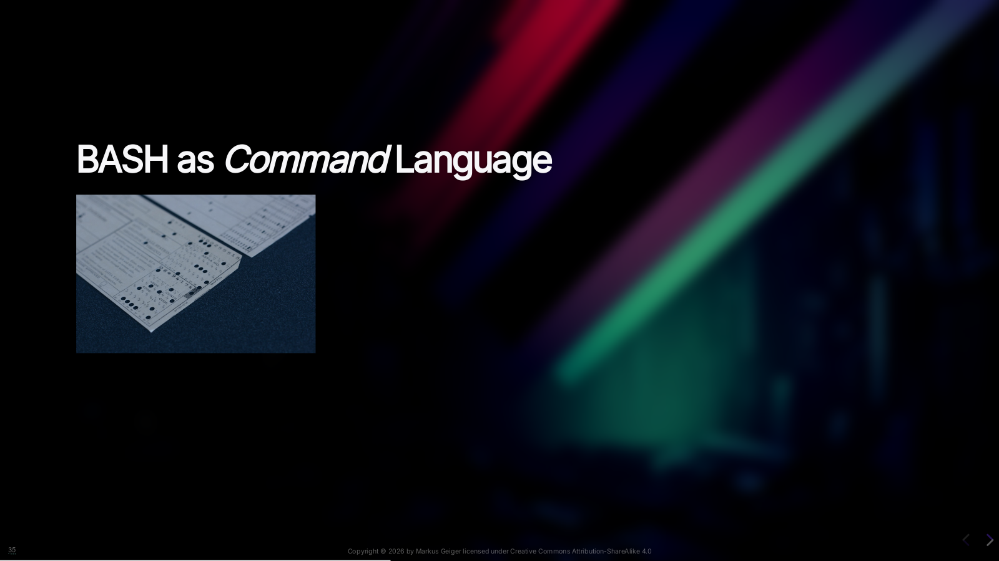
Notes:
Here you see the origin of Linux commands. Once computers were driven by physical command cards. The output was on a printer. The input was, well… you see it in the picture. If the command was successful it quit with SUCCESS. Otherwise you would get an error code. Later people typed commands into a terminal. And still you do exactly that in BASH! In BASH we have commands. And it will be also helpful to understand bash functions later primarly as “commands”.

Slide 39
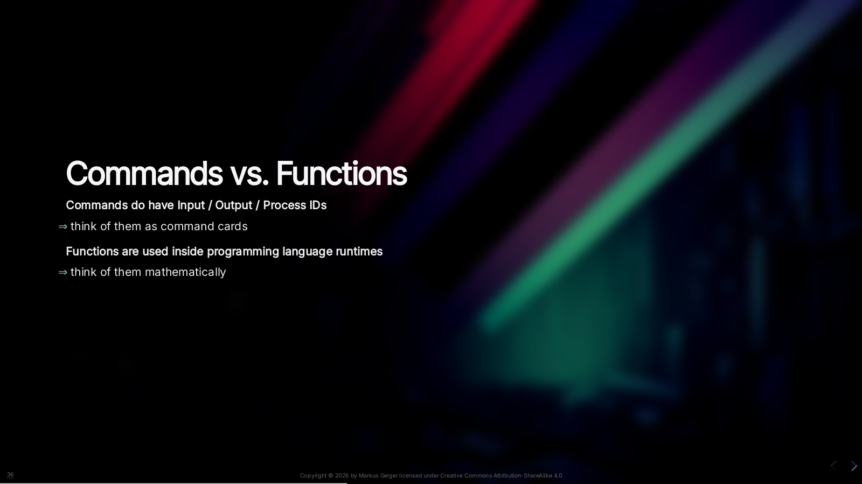
Notes:
A command is usually executed as one or more processes. And like functions commands can also be chained together. Therefore we also have the POSIX standard that describes how it has to work and what to support.

Slide 40
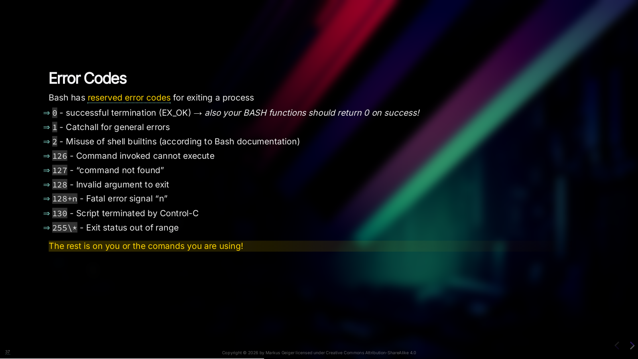
Notes:
We don’t have exceptions in BASH.

Slide 41

Notes:
A POSIX process can be sen as synonym to Linux process. A command is usually executed as one or more processes. So, we have end up a process with an input, an output and antoher file descriptor connected as error output. We don’t have WARNING or INFO or fancy Exception stuff. If you want logging output use Standard Error – and only that! And probably use JSONL as output options. Or if you want to go non-standard ways you still could add custom file descriptors. And then we have a terminal – I mean virtual terminal. We have kernel device called ptmx which is the pseudoterminal master. From there we spawn slave terminals. And the terminal is both an input and output device.

Slide 42


Slide 43
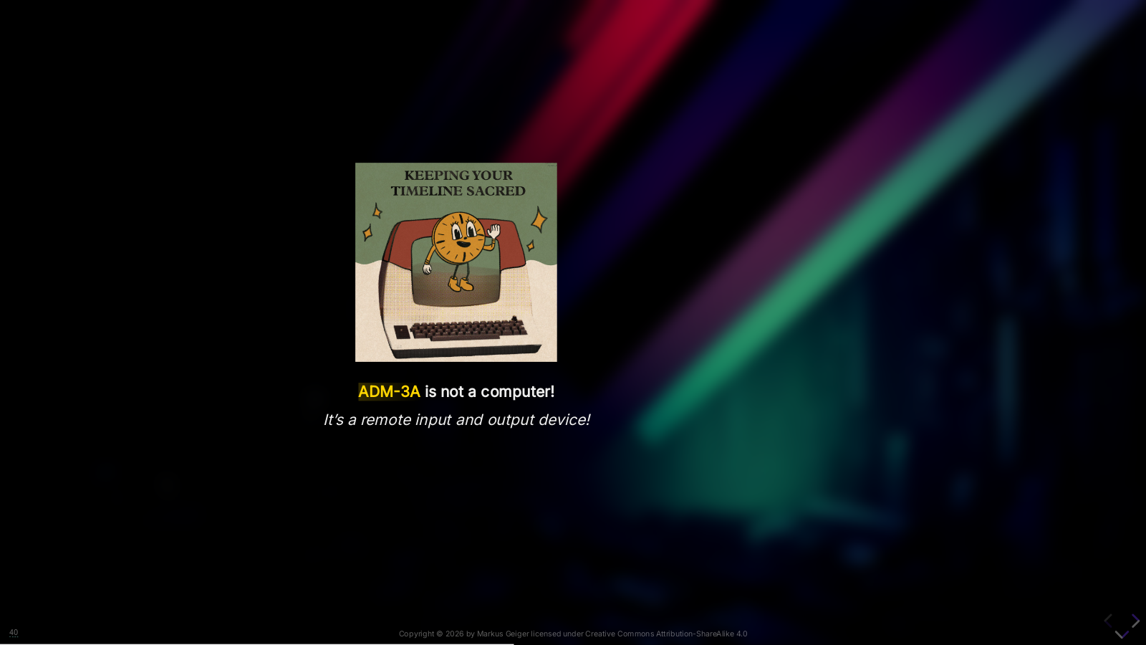
Notes:
This is NOT a computer! Remember: there were days that people had terminals at home that were connected to a computer in the computing center. Here we see an [ADM-3A](https://de.wikipedia.org/wiki/ADM-3A) as seen in the Disney+ or Marvel series Loki. At the beginning of their existance they could not do much more then entering text and just froze when they lost connection to the server. Therefore called “dumb terminals”. Later control or escape sequences were introduced to do “advanced stuff” like cursor positioning, scrolling or clear screen and do other fancy stuff like color.

Slide 44
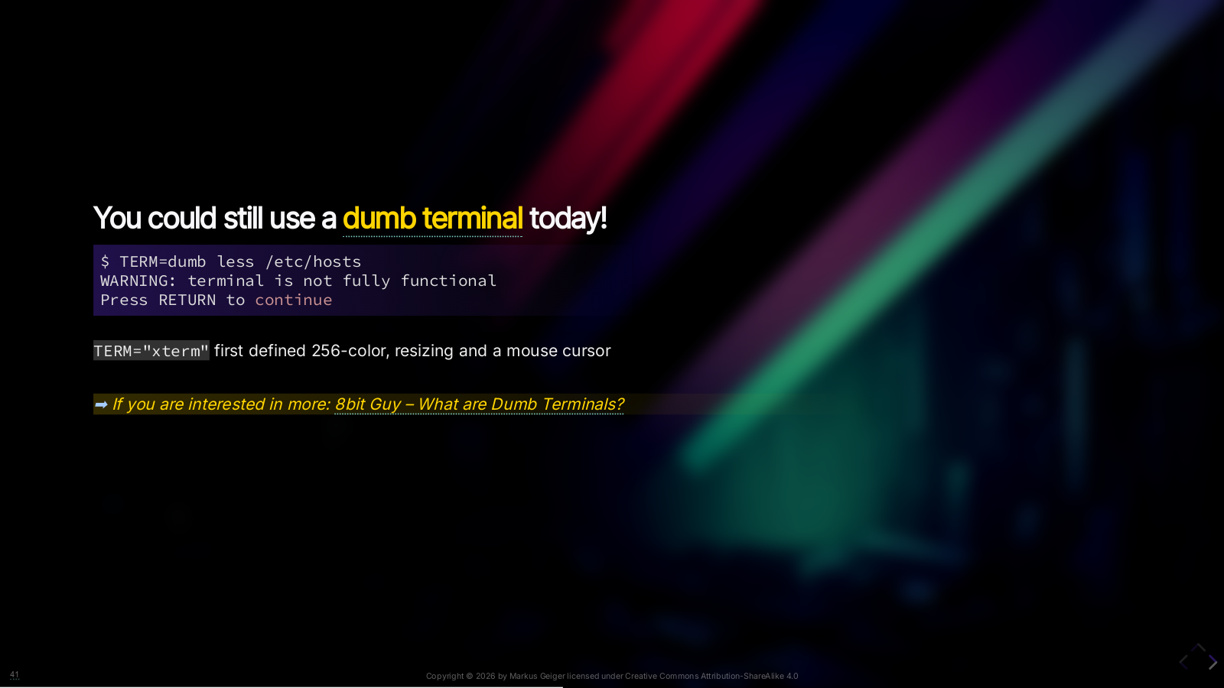

Slide 45
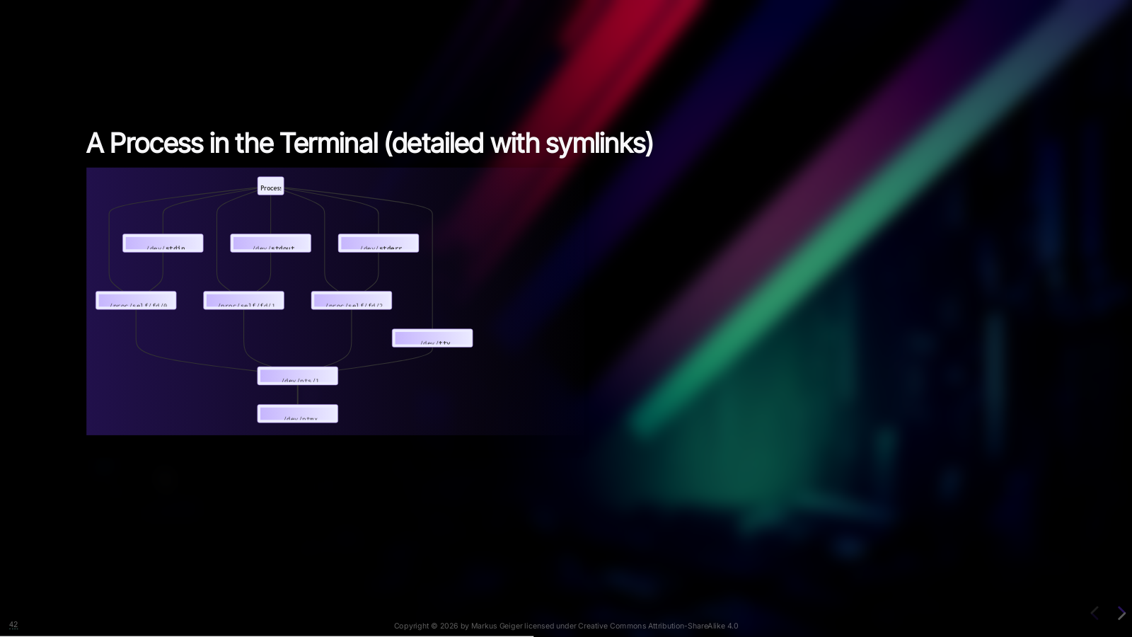
Notes:
Back to our process. We also have to add some symlinks attached to each process. We’ll be using that later. * `/dev/stdin` → `/proc/self/fd/0` * `/dev/stdout` → `/proc/self/fd/1` * `/dev/stderr` → `/proc/self/fd/2` * `/dev/tty`→ `/dev/pts/?`

Slide 46
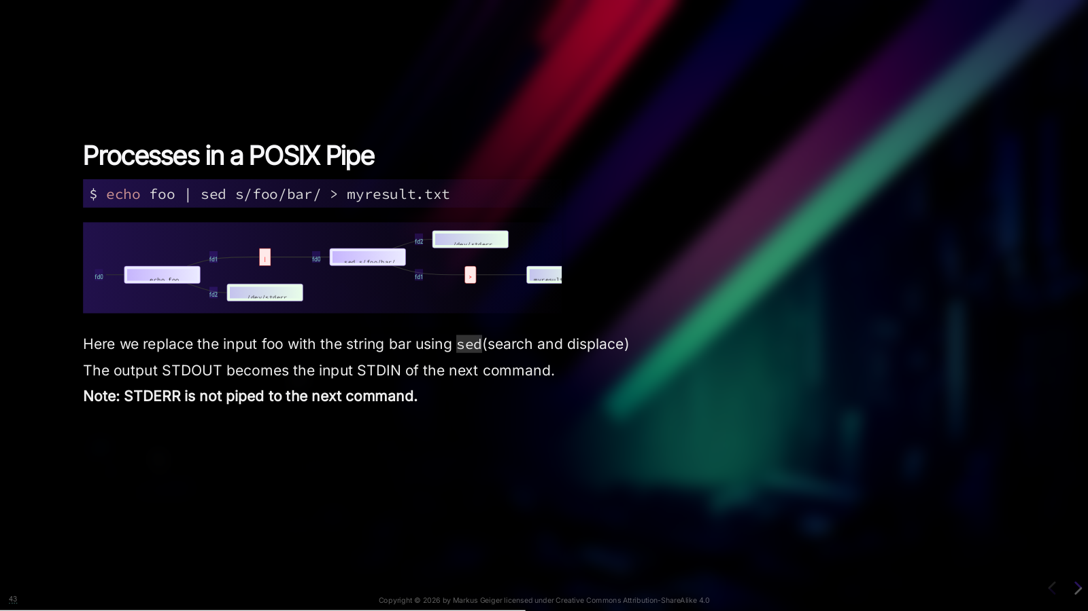
Notes:
The power of \*nix is to being able to chain commands into a pipe – thus a chain of commands. Important thing to note: STDERR is not piped thru!

Slide 47
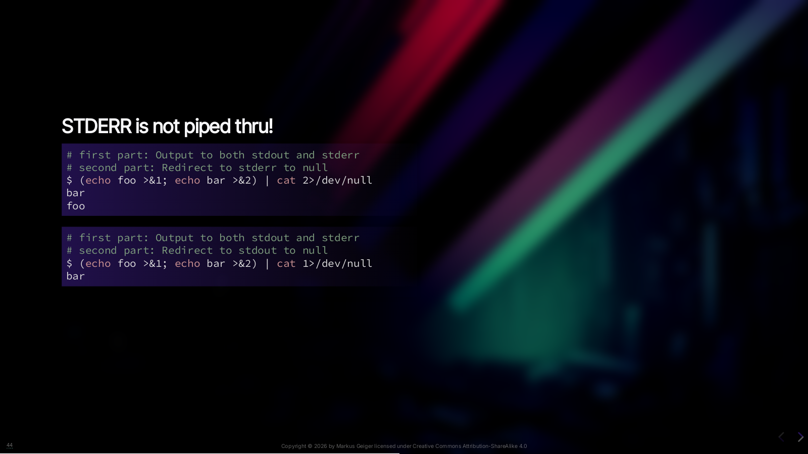
Notes:
Another example: We use `cat` to putput stdin to stdout. The parenthesis around the two `echo`s mean that we execute within a subshell , thus becoming the parenthesis a “command” on it’s own. First example.: 1. We output `foo` to `stdout`, and `bar` to `stderr`. 2. `stderr` is printed out within the first command thus we see `bar` on the terminal 3. `bar` becomes `stdin` to `cat` hence we see `bar` on the terminal 4. …and we redirect the `stderr` of `cat` to `null` – which has no output – note we have seen `stderr` output of `bar` already Second Example: 1. Basically the same 2. But we redirect the output of `stdout` on `cat` to null device thus we see only `foo` from `stderr`

Slide 48
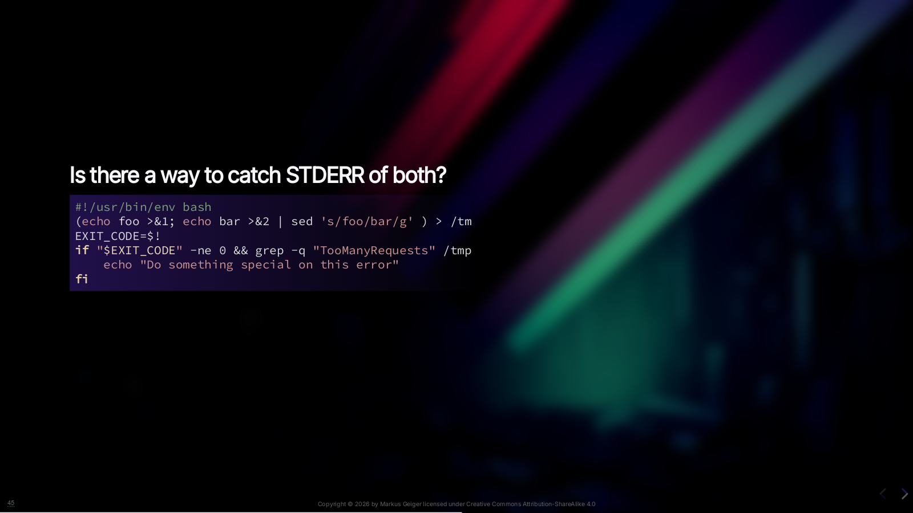
Notes:
Why do I show this? First, to clear up misconceptions. Second, since checking error logs sometimes is the only way to react to certain errors. And you might use that in your Gitlab pipelines Third, we’ve seen a bit more complex example: If the command here failed (means exit code un-equal zero) we check for the string “TooManyRequests” in it’s error output and could follow some retry logic. You may use similar in your scripts. And forth: since I don’t have time to explain everything in this talk you can dissect this lines by…

Slide 49


Slide 50


Slide 51
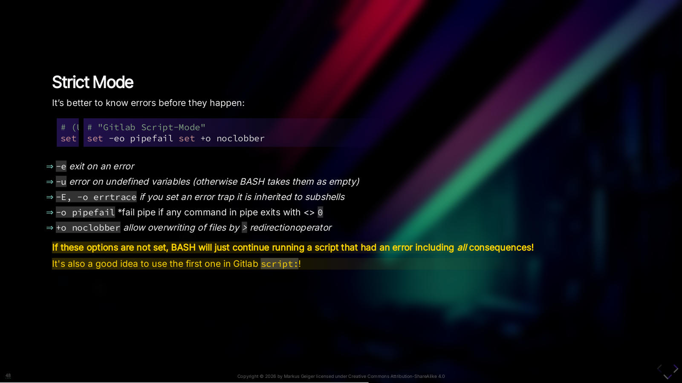
Notes:
It’s better to know errors before they happen. So you don't need to debug. I always start my scripts using this preamble. We do set BASH options her. So what do they mean? *(Read Slide)* Clobber: BASH default allows overwrite For Adanced Users: Even there is the possibiltiy to put options into a shebang you shouldn’t since * options won’t be executed when including scritps or calling with explictily with `bash myscript` in CLI. * Also some options are version dependent. NOTE: If these options are not set, BASH will just continue running a script that had an error including *all* consequences! Including removal of files or other destructive actions!

Slide 52


Slide 53

Notes:
The `-+` is purely historical. `-` was first to set options. Later something was needed to unset, hence `+` came along.

Slide 54
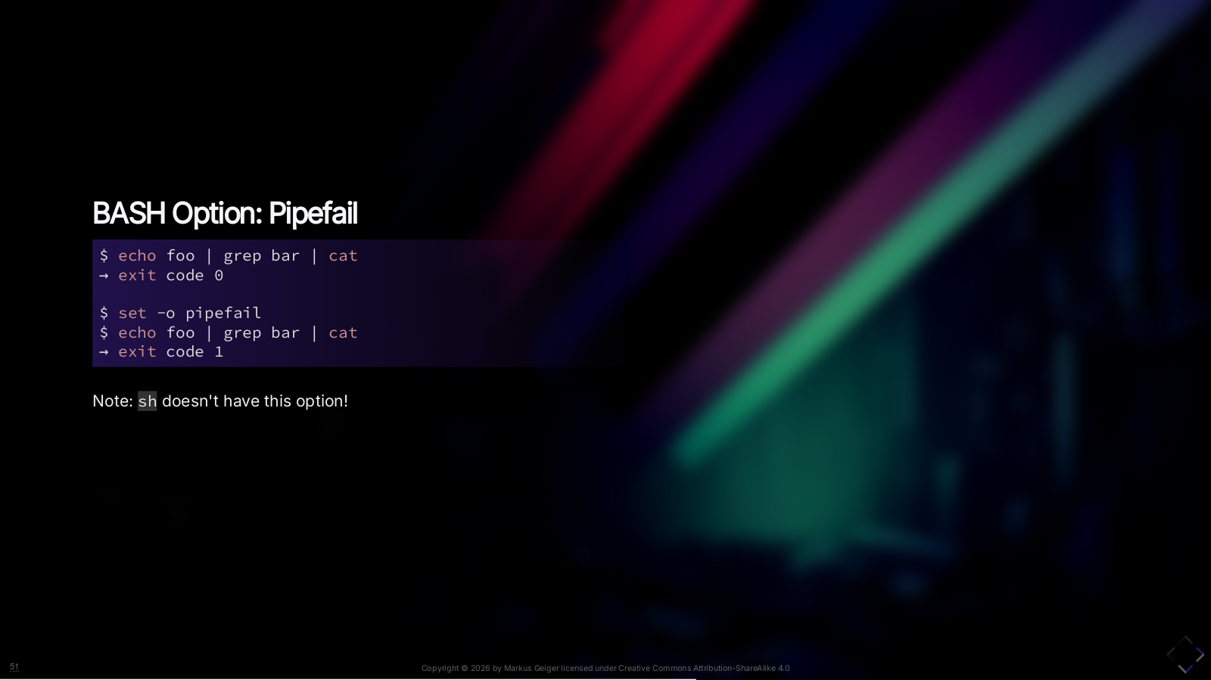
Notes:
Let’s have a look on the effects of these options and the how to cure…

Slide 55
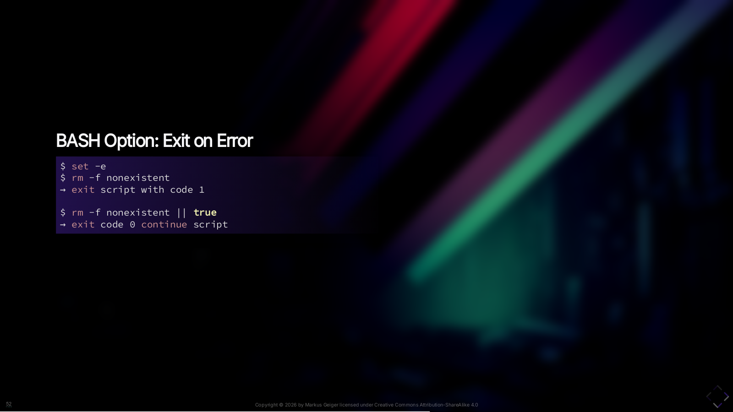

Slide 56
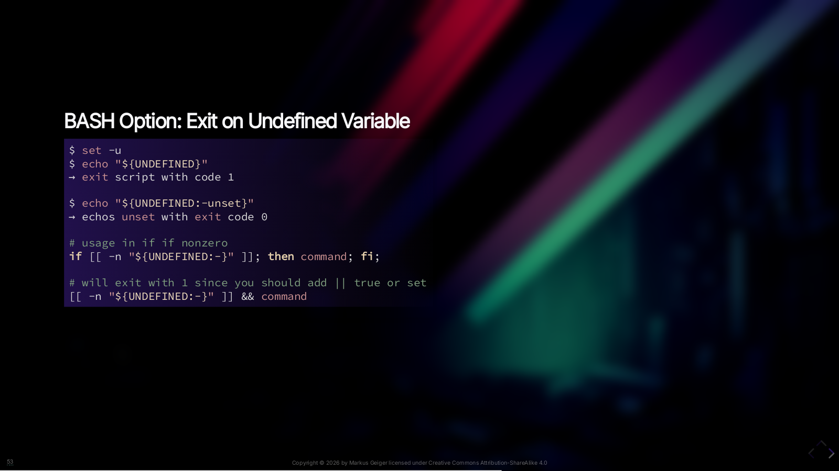

Slide 57


Slide 58
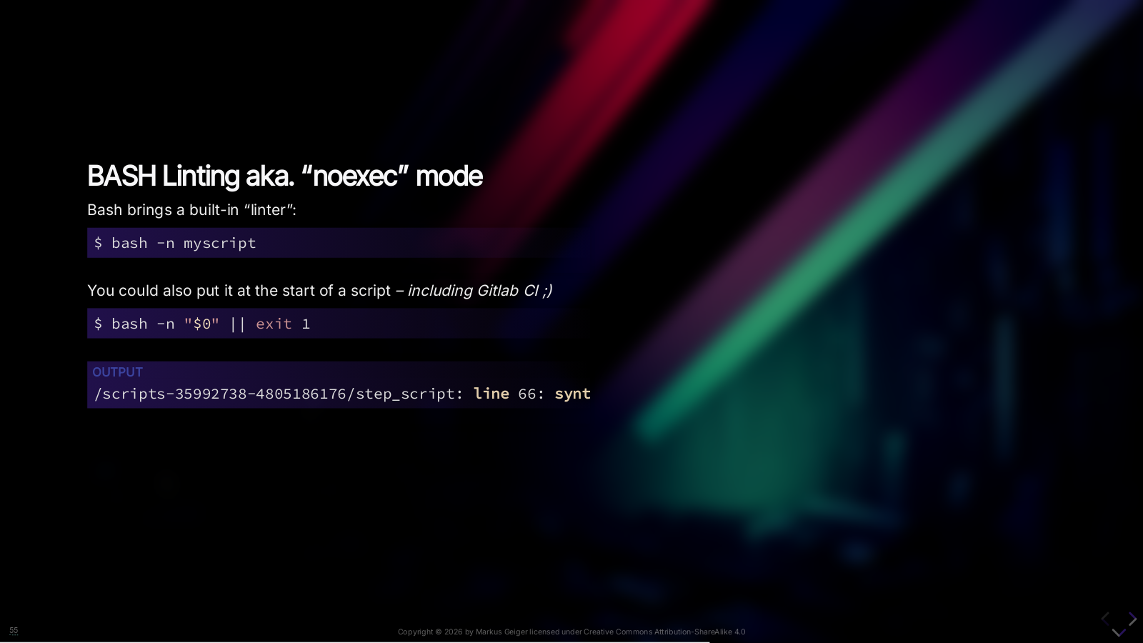
Notes:
Bash brings a built-in “linter” The usage is straight-forward. Just add the `-n` option. And you could also put it that at the start of a script *– including Gitlab CI ;)*

Slide 59
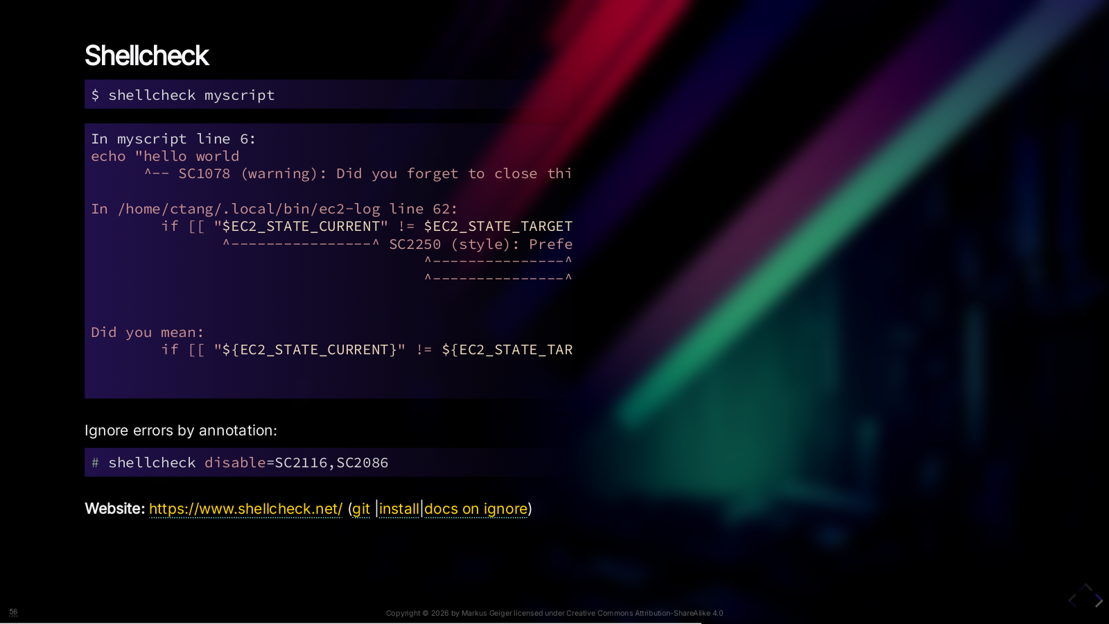
Notes:
Shellcheck is a well known and good tool for syntax checking and linting. It throws a lot of WARNINGs BUT usually if it throws ERRORs you have ERRORs! Also it is very good at recognizing where parenthesis or quoting start/end errors. You definatly should follow some if it’s sugestions since when you write SH scripts for systems they are run by varias SH implemetations and diffferent shell options. Anyway, you can ignore errors by annotation or within CLI usage. Write a wrapper ro aais for it.

Slide 60
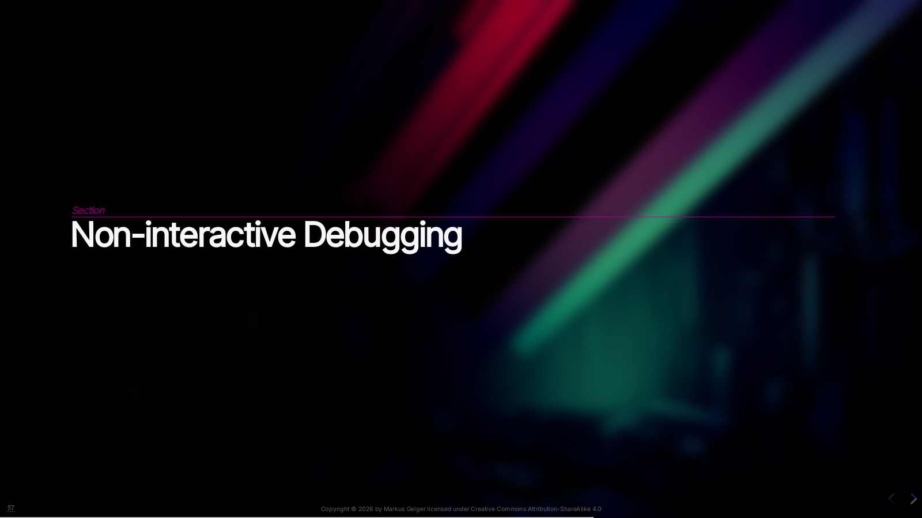

Slide 61

Notes:
xtrace is is another SH option you can use. BASH also supports function tracing which you should enable.

Slide 62
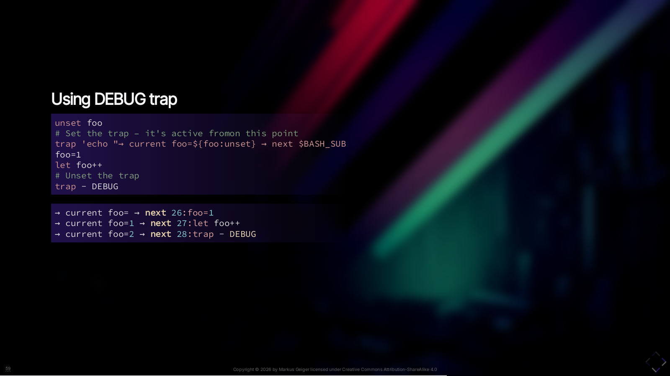
Notes:
Then we could use a debug trap. And as you see we could also add more code to it. Here we are tracing the variable `value` Indeed we can also call a function here, but BASH variables may change…

Slide 63
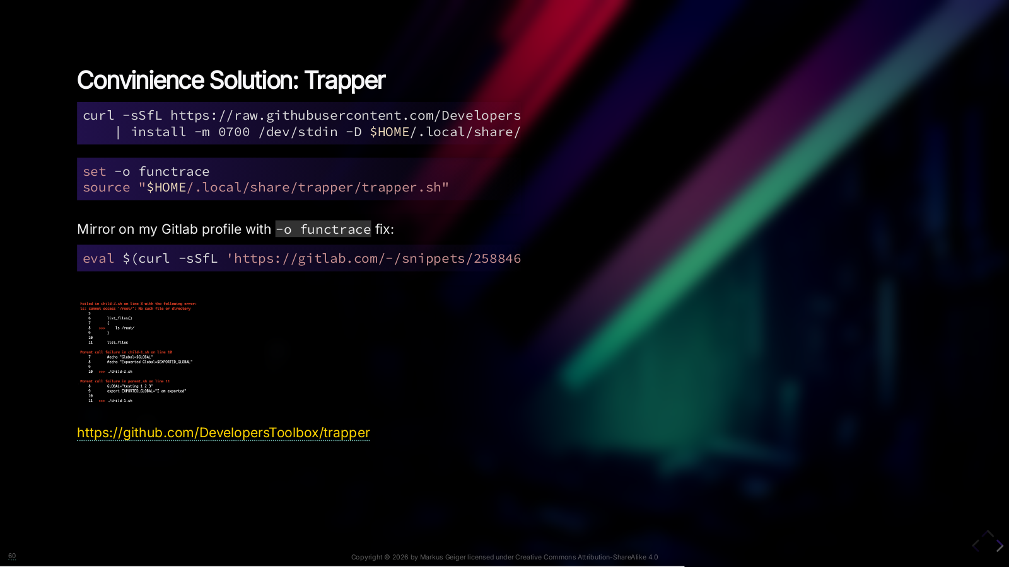
Notes:
Trapper doesn’t excatly show you each processed line but does show some very good error output. I mirrored and `-o functrace` which is missing in the original version.

Slide 64

Notes:
This scripts can be used for local debugging. Partly also in CI.

Slide 65
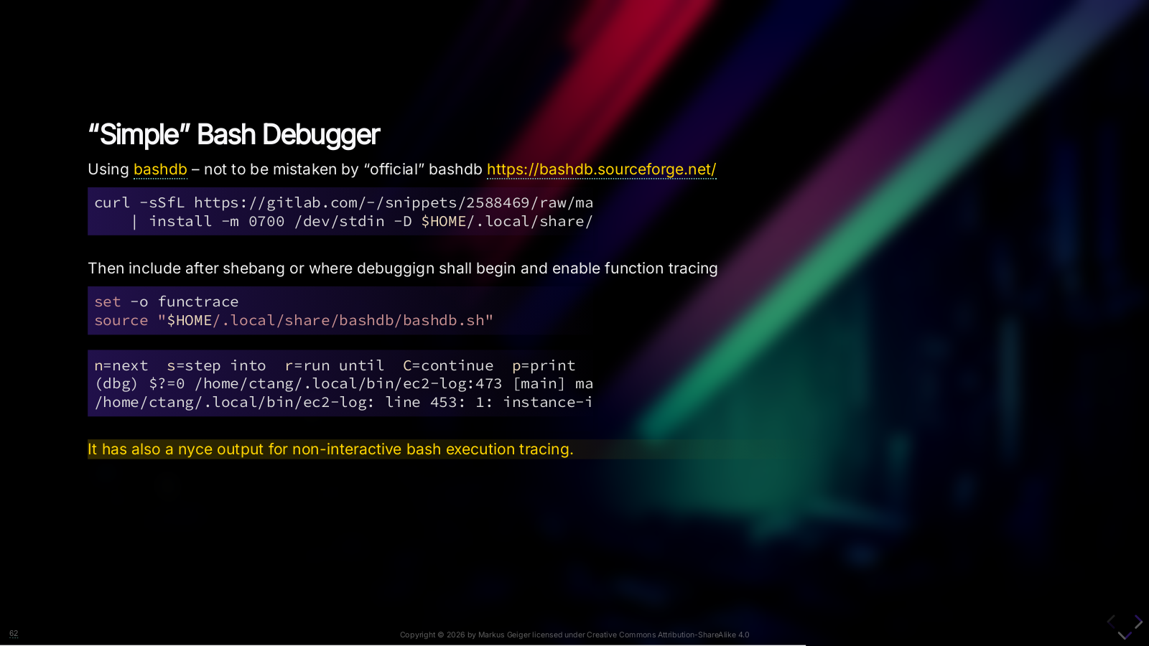
Notes:
One such thing is the `bashdb` script I found in a GIST. There is a *somewhat official bash debugger* with the same name of `bashdb` but at the time of writing it does not support BASH 5.2 and BASH 5.1 is *just* in git. On sourcefourge – not GitHub. You can install it on Ubuntu20 as system package for it. Ubuntu22 doesn’t have it (since it has a newer BASH version). It’s a bit tricky. Use that script here instead. It just traces code execution in your script. I also mirrored that [gist](https://gist.github.com/rene-d/fd2d2c37dfc1371255818d73f7b5f1db/raw/bashdb.sh) on my Gitlab profile.

Slide 66
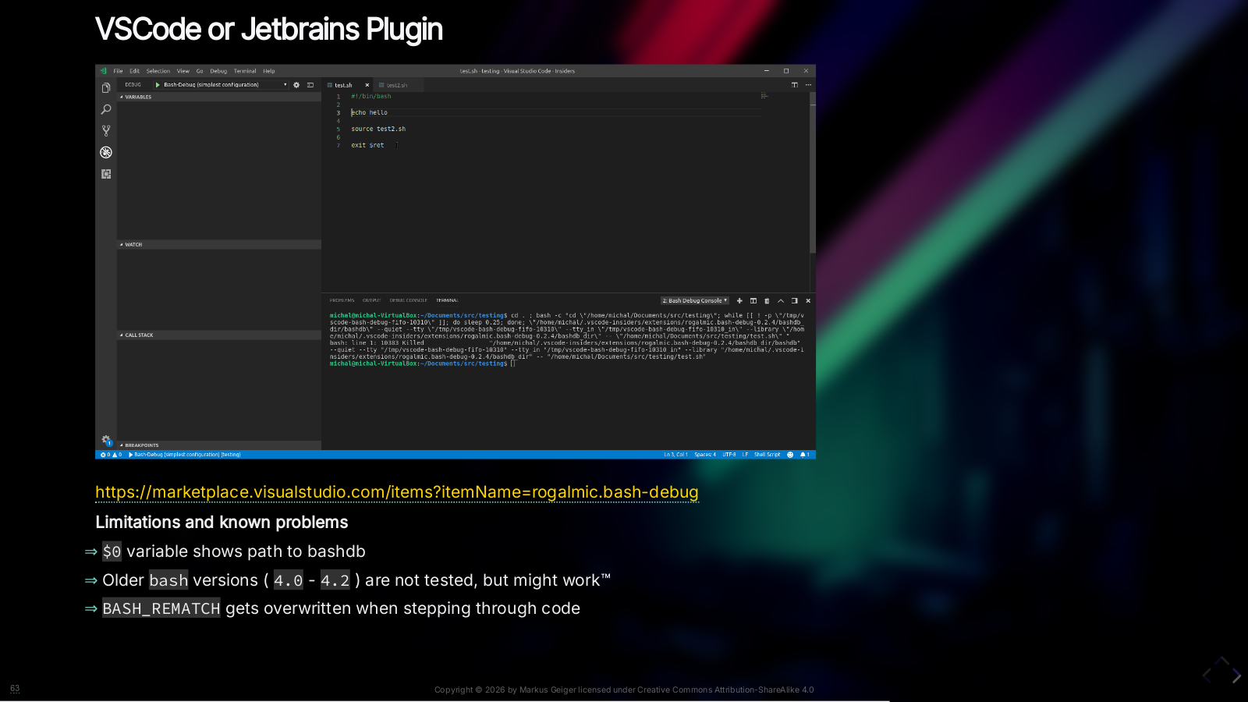
Notes:
Of course you can use your IDE to debug. The plugins are by the same author(s) of the the “Offical BashDB” in use. Therefore it uses “Offical BashDB” * <https://bashdb.sourceforge.net/> * <https://sourceforge.net/p/bashdb/code/ci/bash-5.1/tree/>

Slide 67


Slide 68
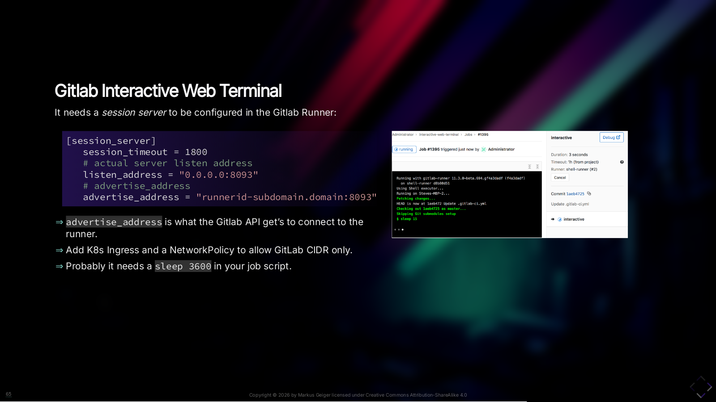
Notes:
First you need a session server within the runner config. It tells the Gitlab API where the Runner can be found. Then the GitlabAPI connects back with the job id after you clicked the debug button in the UI. You need to setup an public available address to connect the runner to. The subdomain could be randomized of course. Once it works you probably still need to add a `sleep` to yourto deb\` Don't use 3rd party Ingress-as-a-Service like ngrok if you cannot do the domain setup. You will risk a security exception. I'm currently not sure on the status of the implementation of that feature on ACME's Gitlab-Runners-as-a-Service.

Slide 69

Notes:
You still could debug manually if you have access to the Kubernetes Cluster where the GitlabRunner is deployed. First thing is to pause the execution. But after the Runners timeout is reached it will be terminated. Then you identify the pod and connect to the job container.

Slide 70


Slide 71


Slide 72
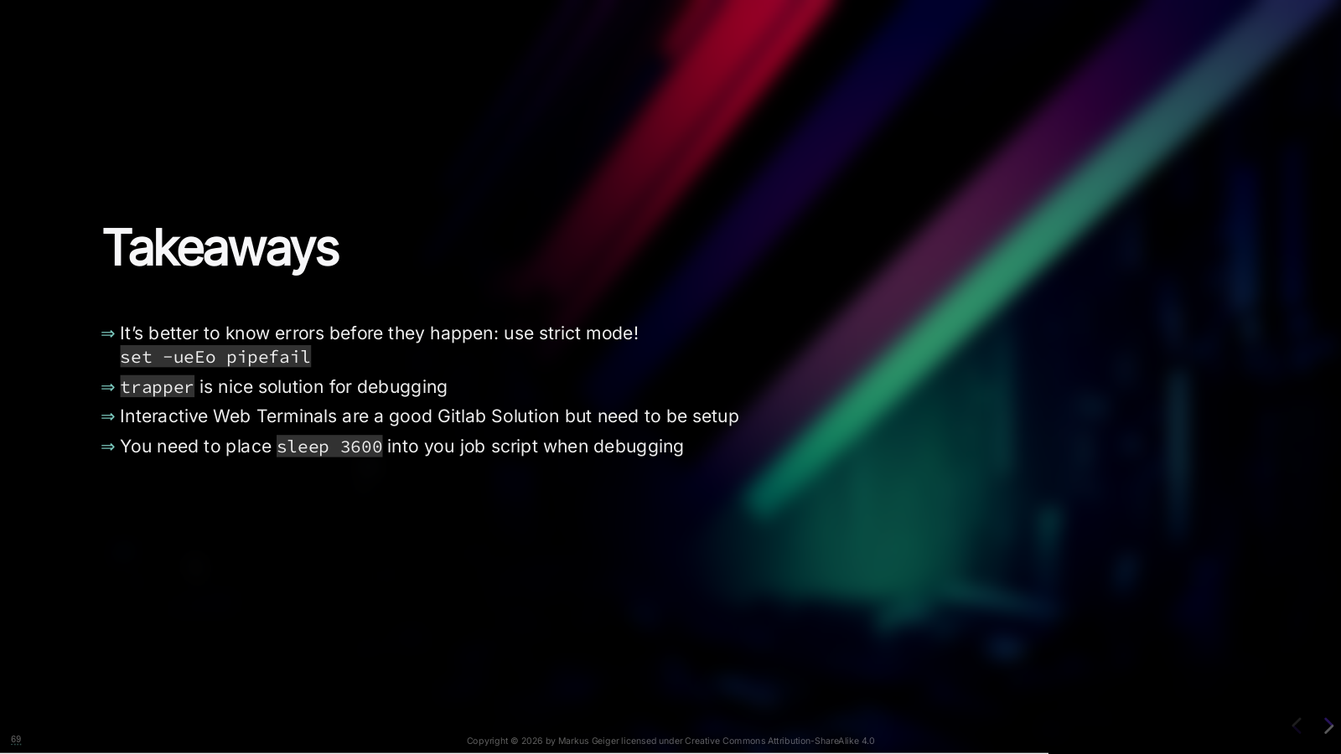

Slide 73

Notes:
Now this is compiled from the VERY best sources with like 20+ years experience on BASH scripting.

Slide 74


Slide 75

Notes:
I want to introduce you to explainshell.com *– which doesn’t use AI and uses Manpages to explain you a command.* And of course you could ask AI which is often correct. Aynway, I don’t think `destroy-the-world` is a fictional command on my system };)

Slide 76
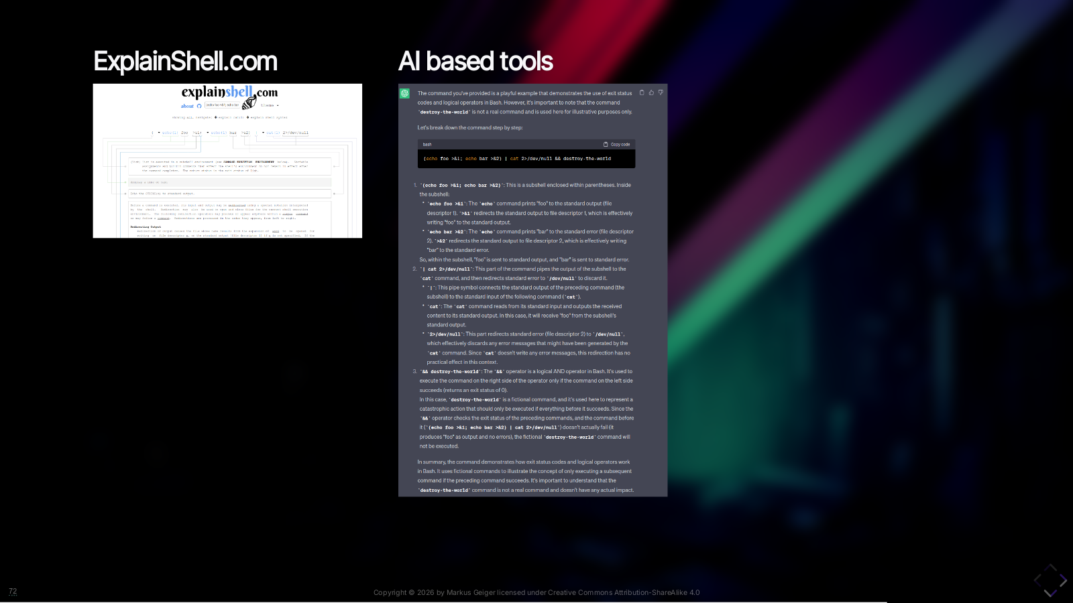
Notes:
I want to introduce you to explainshell.com *– which doesn’t use AI and uses Manpages to explain you a command.* And of course you could ask AI which is often correct. Aynway, I don’t think `destroy-the-world` is a fictional command on my system };)

Slide 77
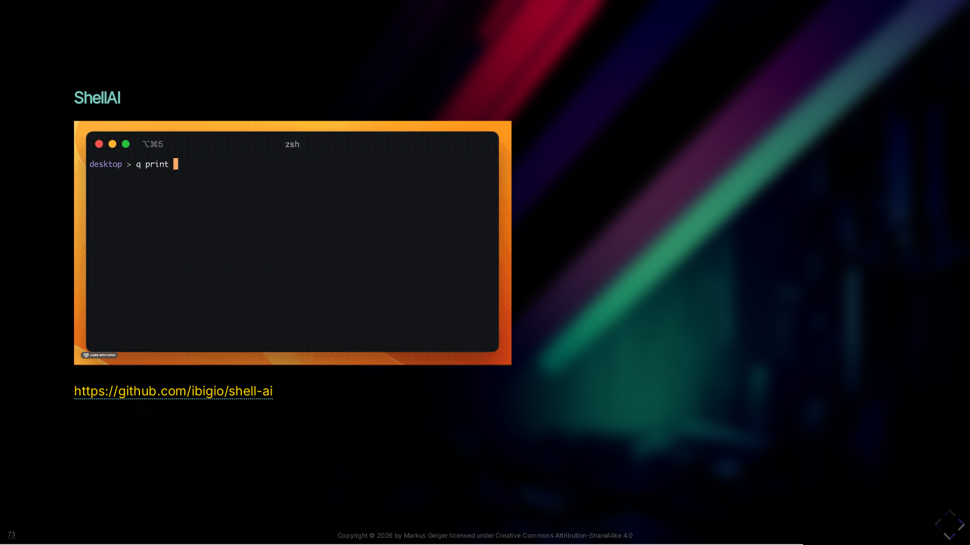
Notes:
I don’t recommend simirarly named project [ricklamers/shell-ai](ricklamers/shell-ai) which is in python except you want to build upon. There you can just select commands that are instantly executed. This golang Shell AI puts you into a REPL and once finished the command is copied to clipboard. Execution and modification is on yours. BTW Also `q` is dumb command since there is another project [q](http://harelba.github.io/q/) which acts as wrapepr around SQLite to query CSVs.

Slide 78


Slide 79
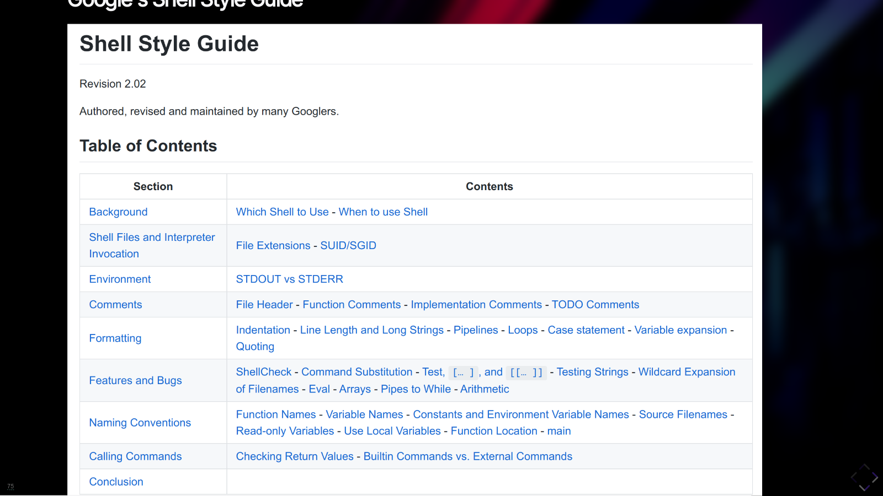
Notes:
You probably know some bash. That's how it is done right voted by a mass of Google Developers (not necessary right)

Slide 80
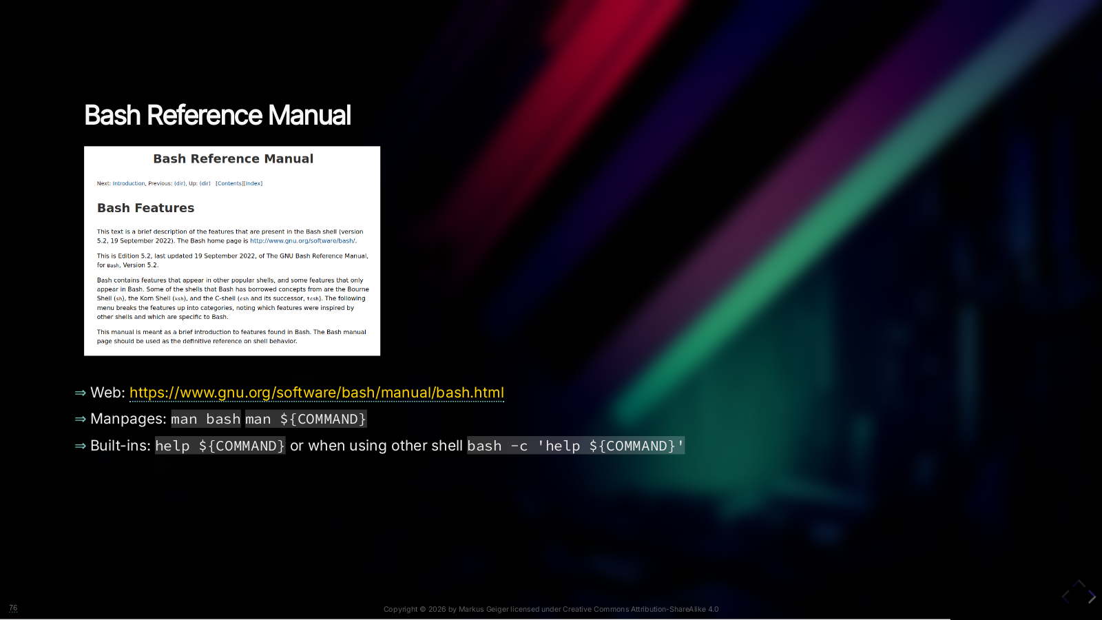
Notes:
Learn by practising is a good. But you also will make many mistakes. And it will be hard to gain the full understanding. Even if you do just cross-reading – Read the Fucking Manual! And still you ask a Large Language Model (LLM). The BASH manual is avaialble via web or via manpages in your shell (something poeple seem not to use anymore) BASH even has a builtin-command to print help on certain (built-in) commands. Built-in commands? We‘ll have this in some moments.

Slide 81


Slide 82
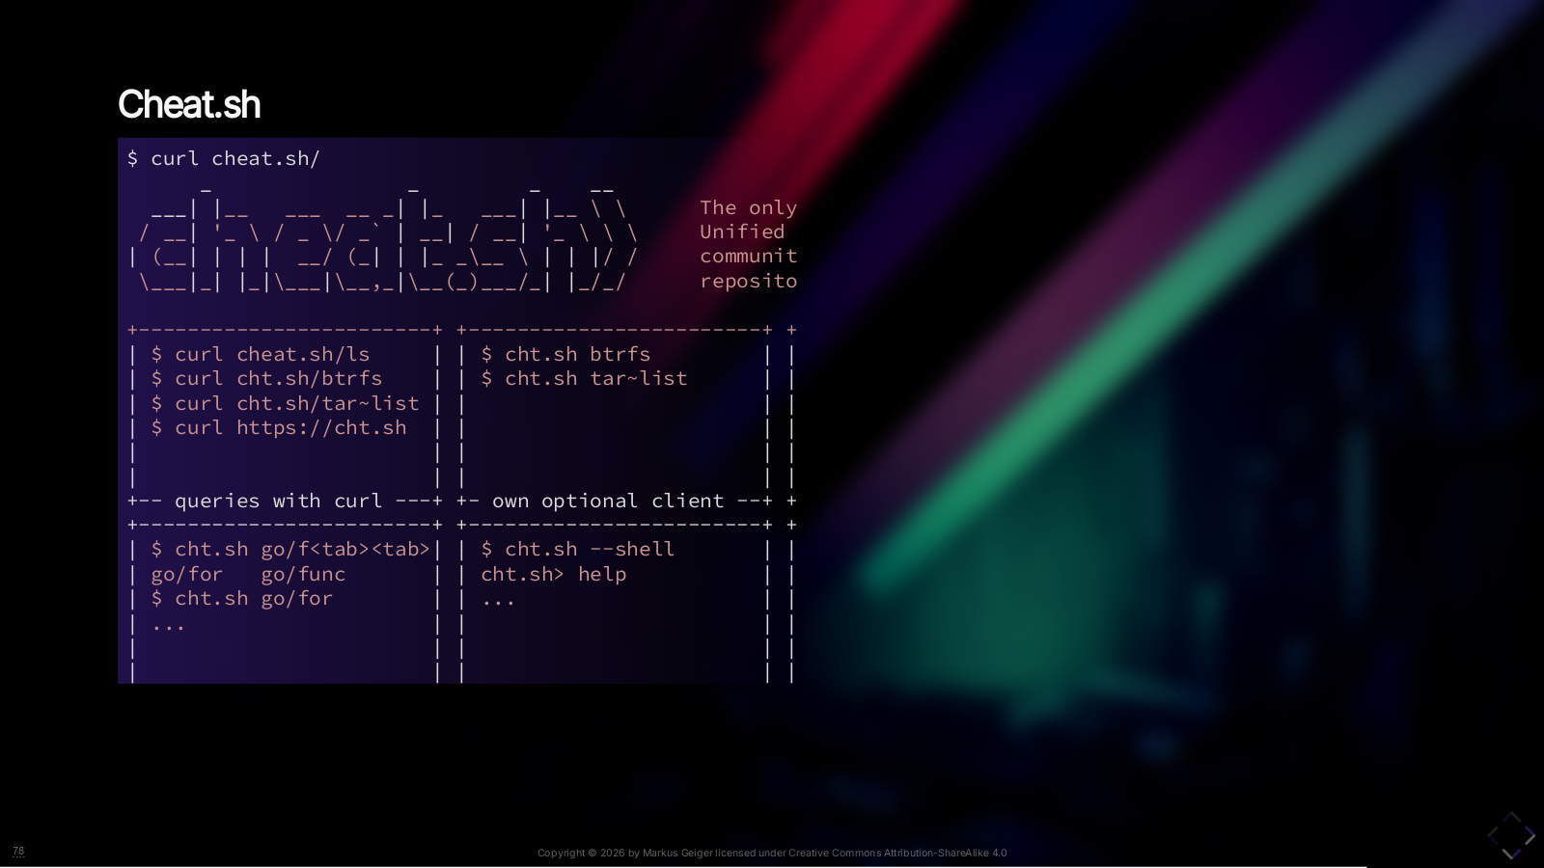
Notes:
Cheat sheet. Oldschool. Big project so far. Good for beginners.

Slide 83
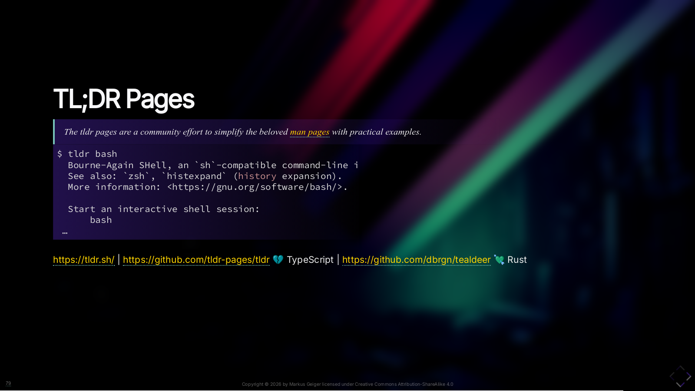
Notes:
Another big collection of examples. Examples are often missing in manpages.

Slide 84

Notes:
Back some years this was probably the biggest collection. It’s more about the art of doing something with one line CLI. I’ll added you a script to query the page from CLI

Slide 85


Slide 86


Slide 87
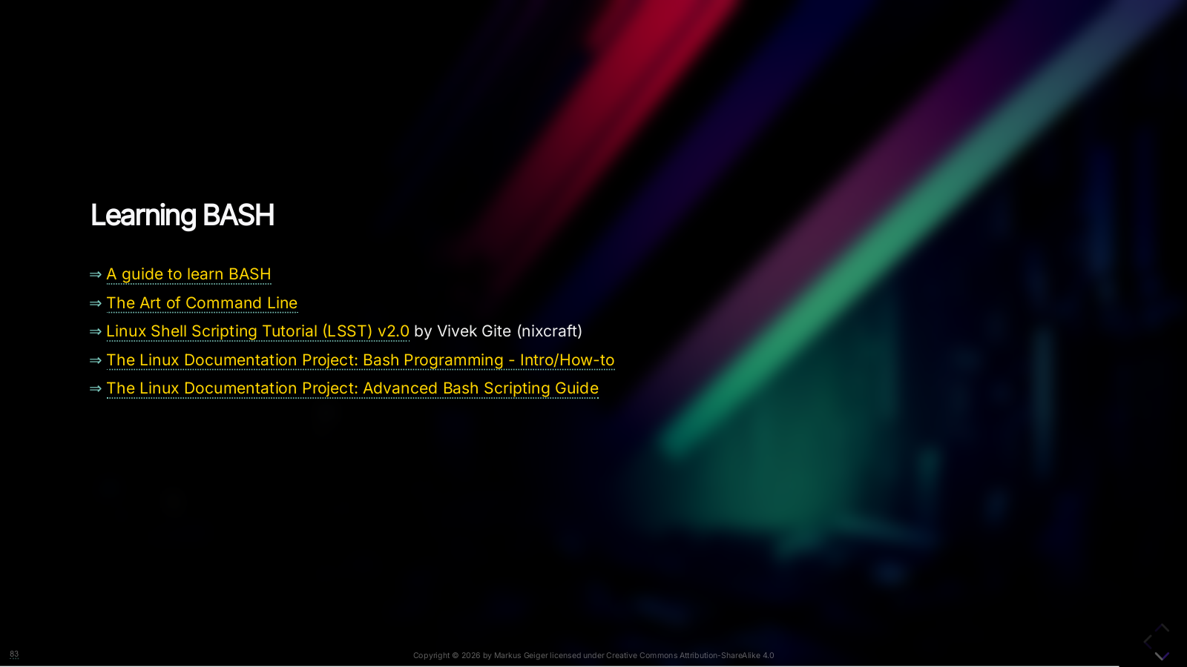

Slide 88
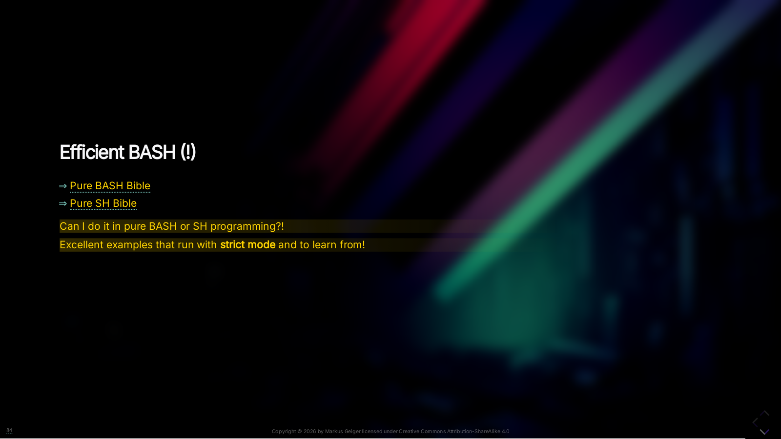

Slide 89


Slide 90


Slide 91


